Slide 1
SLOTHS

Slide 2
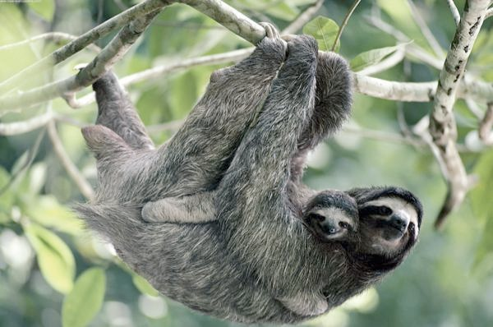

Slide 3
Sloths live in the tropical forests of Central and South America. With their long arms and shaggy fur, they resemble monkeys, but they are actually related to armadillos and anteaters. They can be 2 to 2.5 feet (0.6 to 0.8 meters) long and, depending on species, weigh from 8 to 17 pounds (3.6 to 7.7 kilograms).

Slide 4
There are two main species of sloth, identified by whether they have two or three claws on their front feet. The two species are quite similar in appearance, with roundish heads, sad-looking eyes, tiny ears, and stubby tails.

Slide 5
Two-toed sloths are slightly bigger and tend to spend more time hanging upside-down
Three-toed sloths have facial coloring that makes them look like they're always smiling.

Slide 6
The algae that grows on sloths' fur also helps them avoid predators by letting them blend in with green leaves

Slide 7
Sloths eat mainly leaves and fruit and get most of the water they need from plants. They are clumsy and virtually helpless on land and rarely come down from the trees. About once every week, they descend to go to the bathroom,

Slide 8
http://www.youtube.com/watch?v=q1mAGQAw3Oc - !

