Slide 1
Los Osos de Metenosos
A bear-ly believable tale of some very grammourous students

Slide 2
At Metenosos High School, there is a very outgoing cheerleader named Lola Loslas. She is very outgoing but very direct.

Slide 3
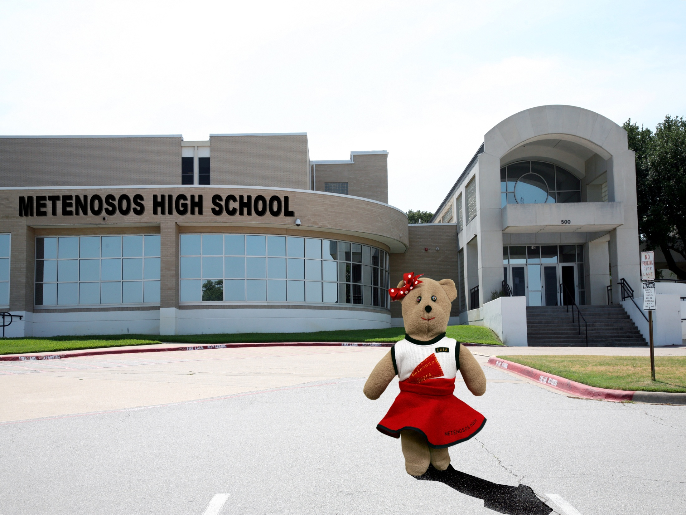

Slide 4
She likes action. She likes people and things. Her favorite phrase is “What’s getting verb’d?”

Slide 5
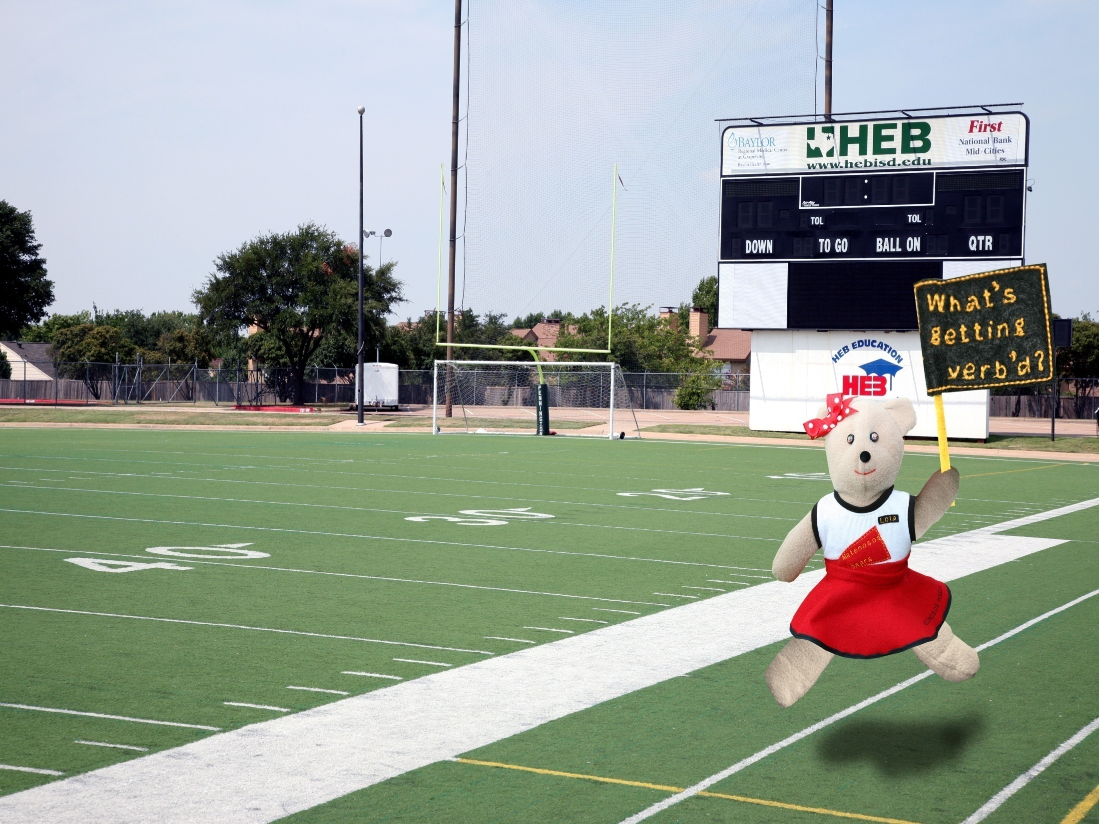

Slide 6
When she does find out what’s getting verb’d…she is dead set on replacing it.

Slide 7
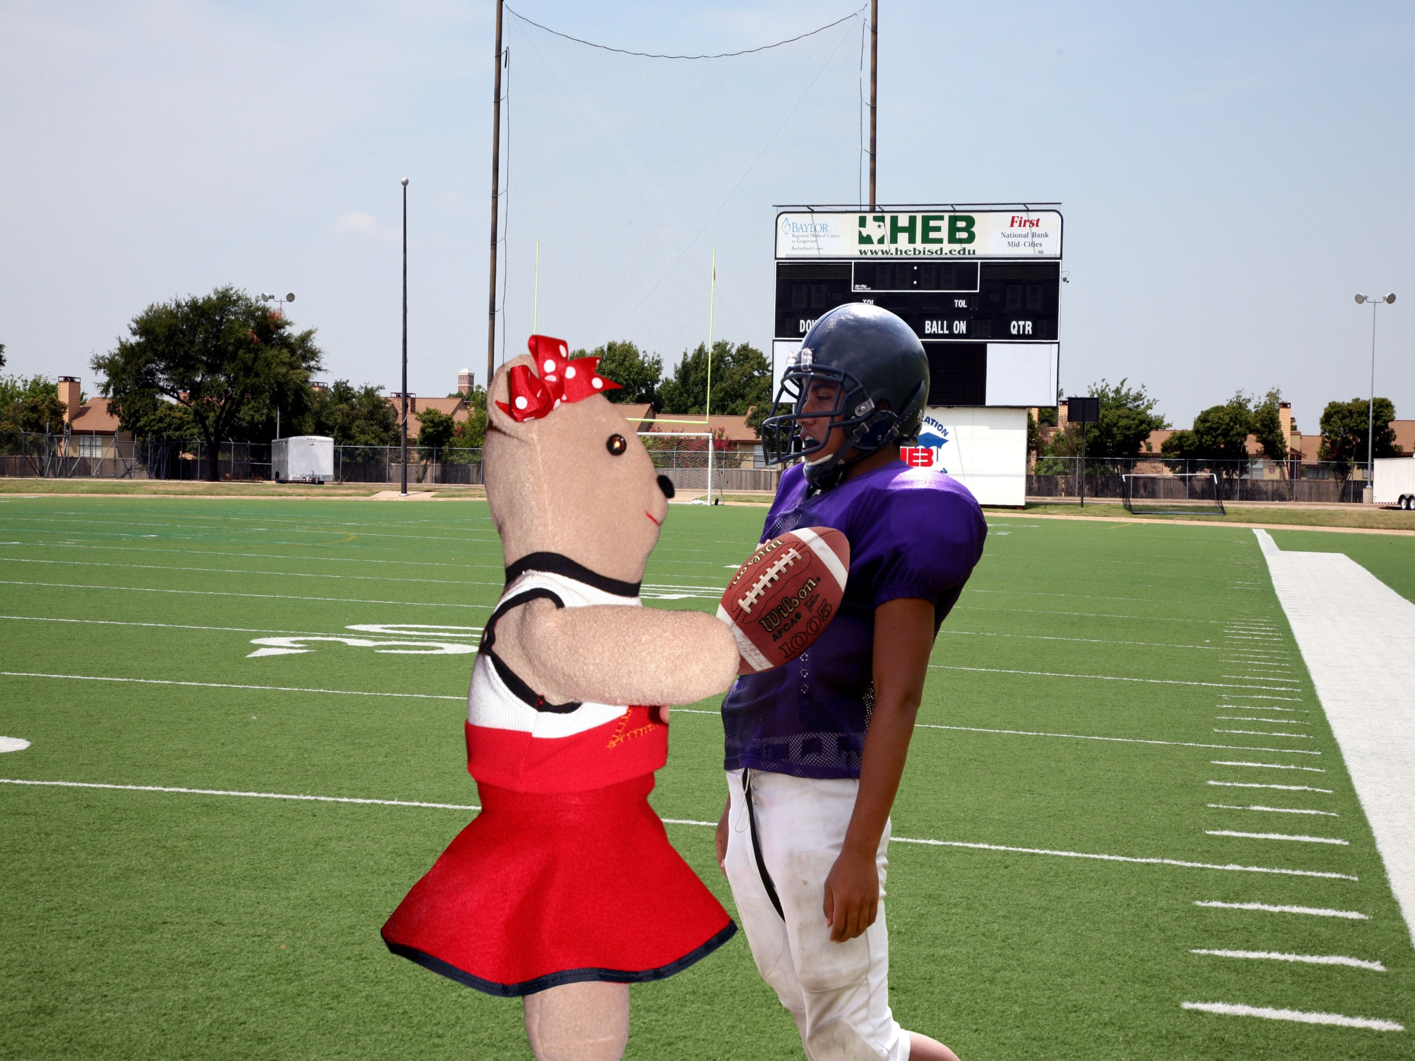

Slide 8
Ella tiene el balón.
Ella lo tiene.
Ella completa la tarea.
Ella la completa.

Slide 9
Although she likes people, there are some students she likes better or worse than others.

Slide 10
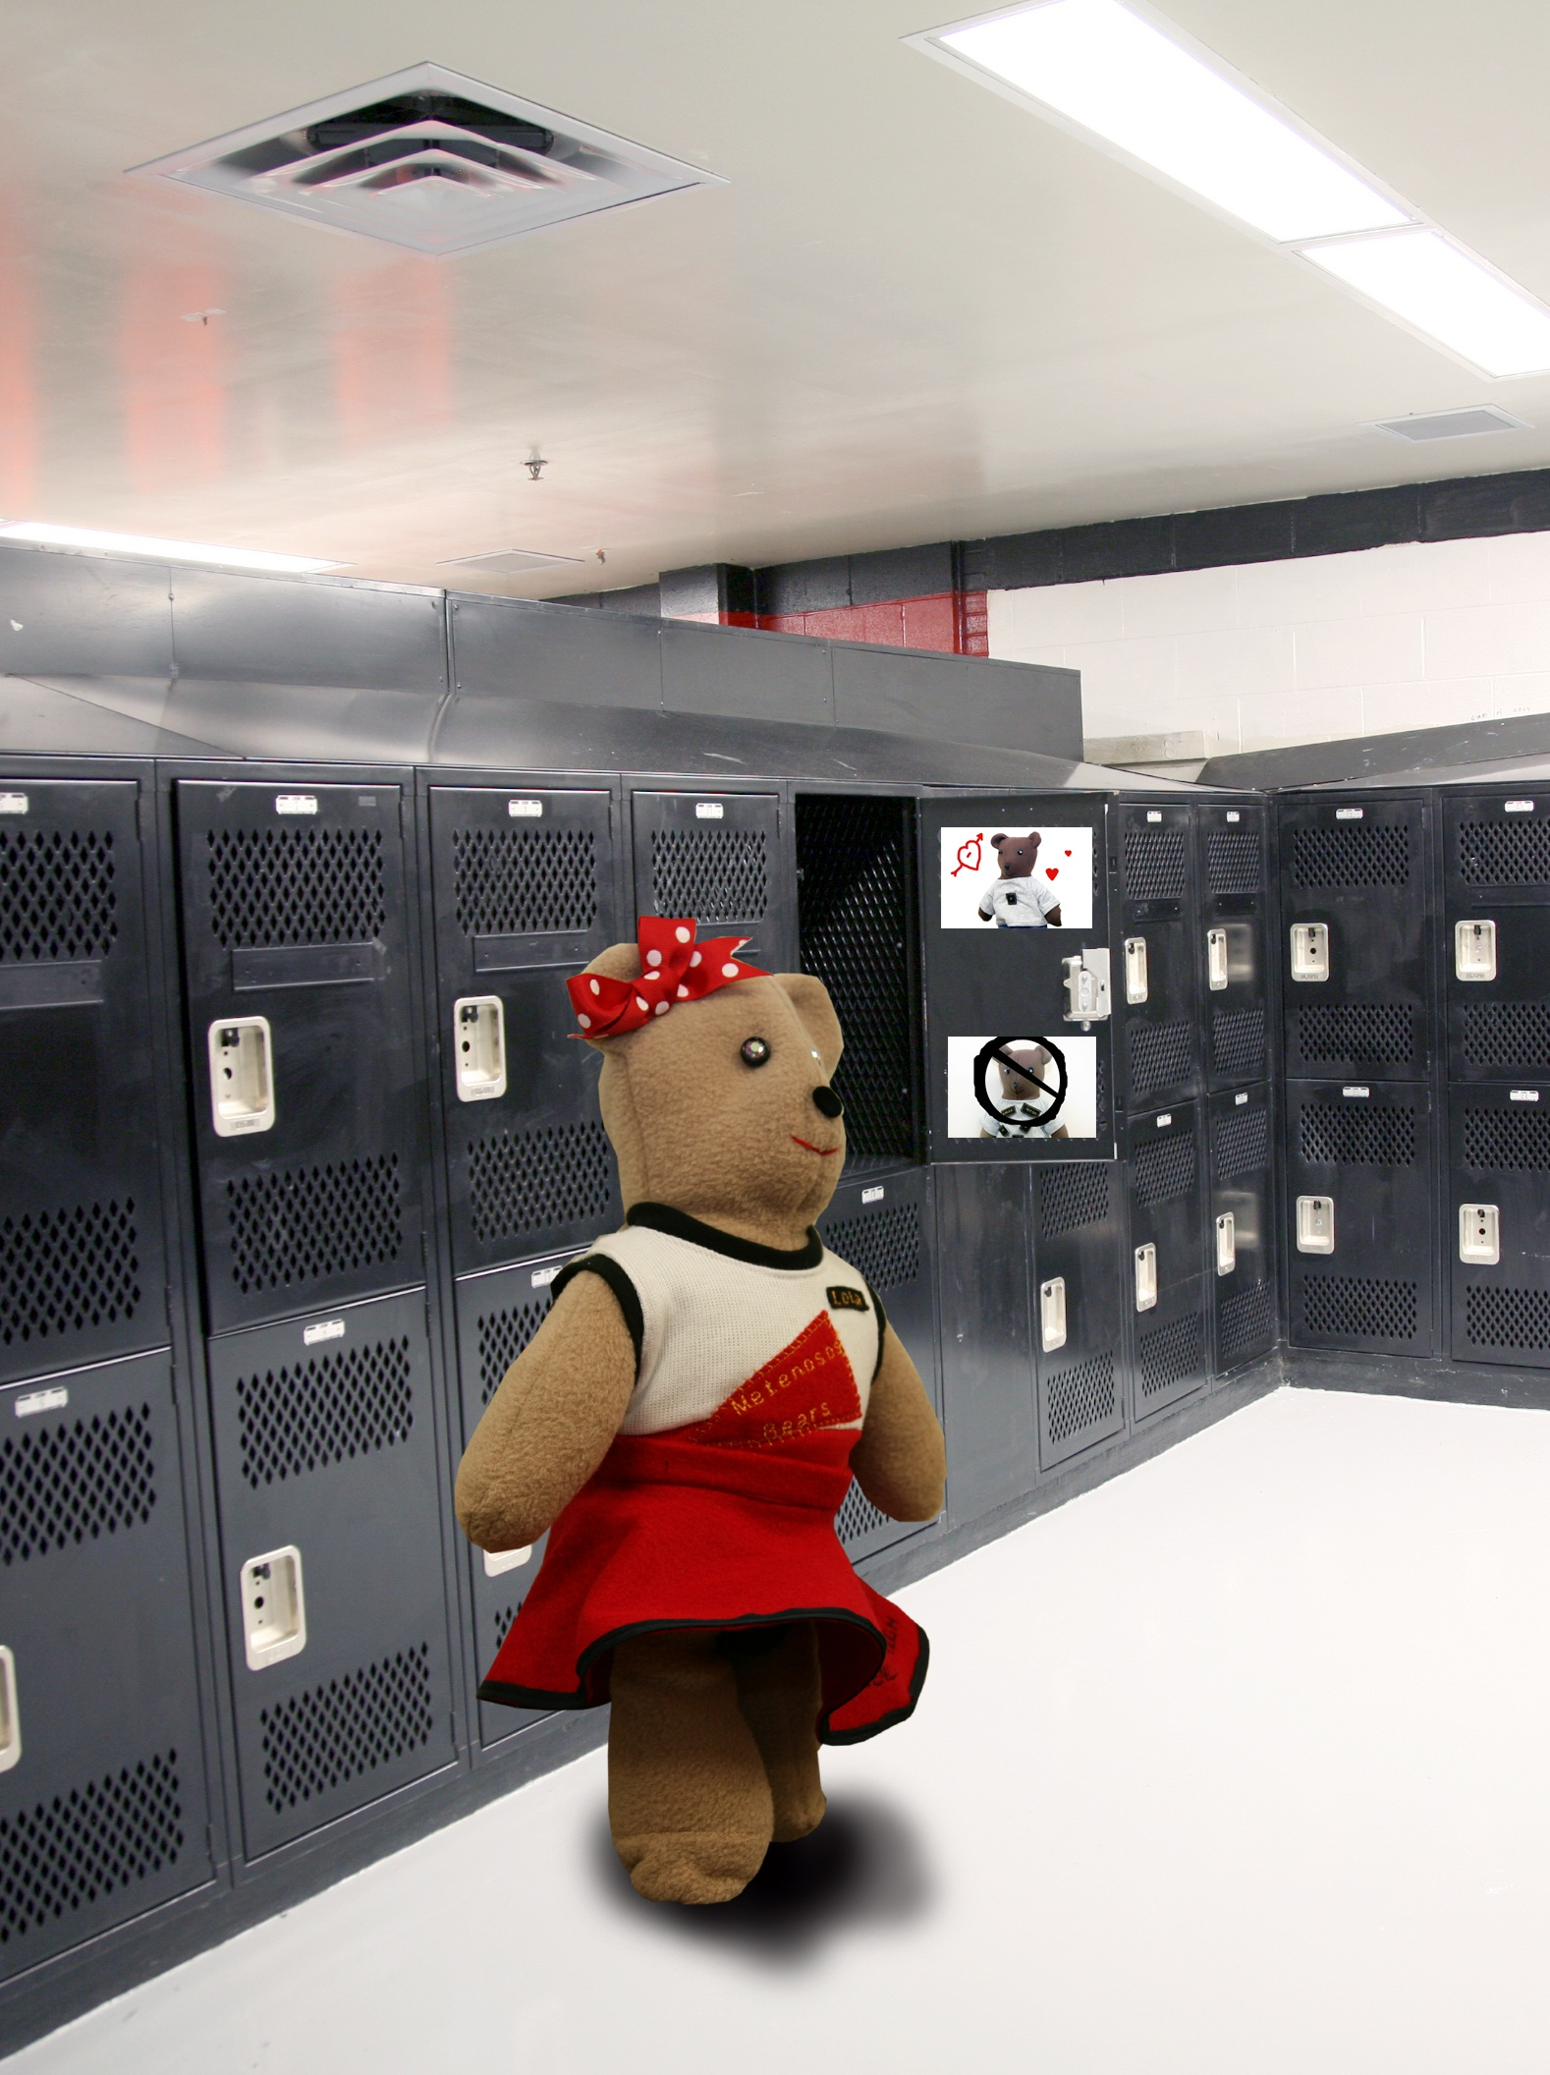

Slide 11
She does not like Negative Commands or Conjugated Verbs. If she sees them in the cafeteria, she will cut in line just so she doesn’t have to look at them.

Slide 12
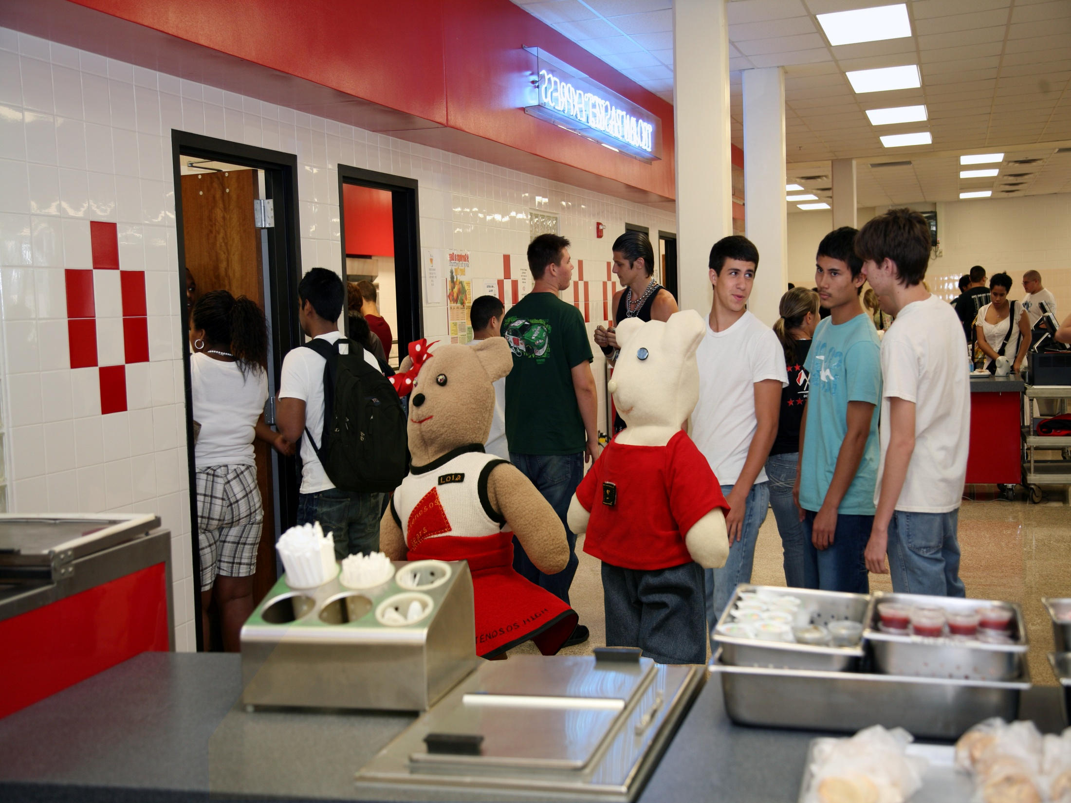
Neg.

Slide 13
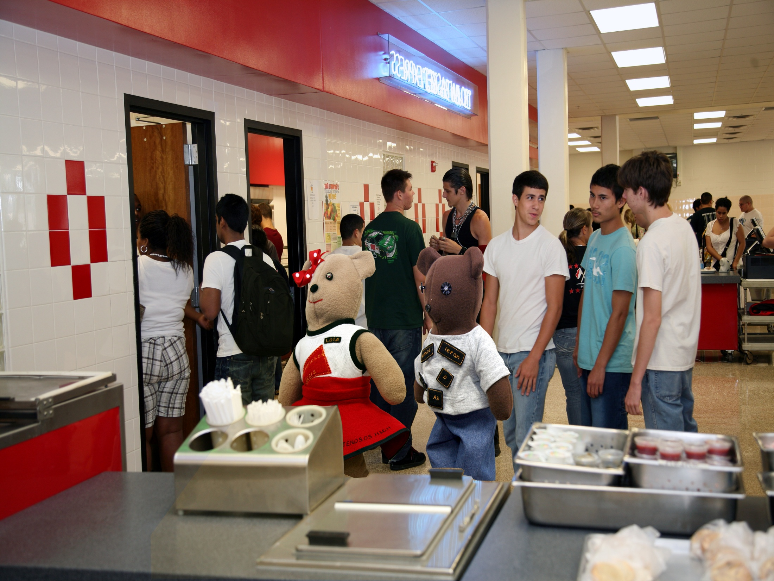
Conj

Slide 14
She loves Positive Commands and Infinitives. She loves them so much she follows them around. In fact, she literally attaches herself to them. Sometimes it’s hard to tell that they’re two different bears.

Slide 15
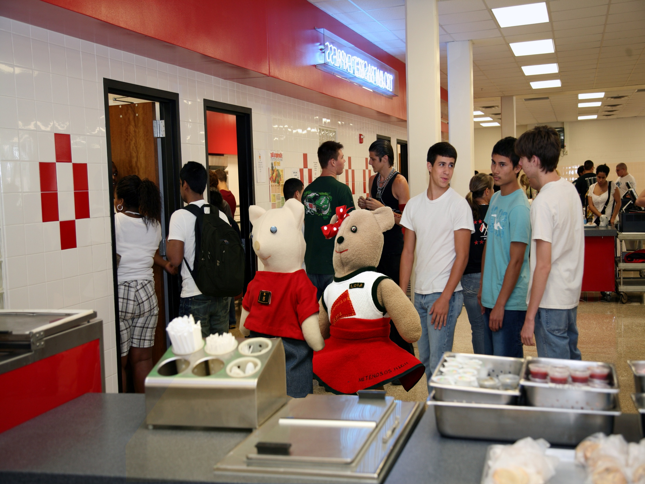
Infinitive

Slide 16
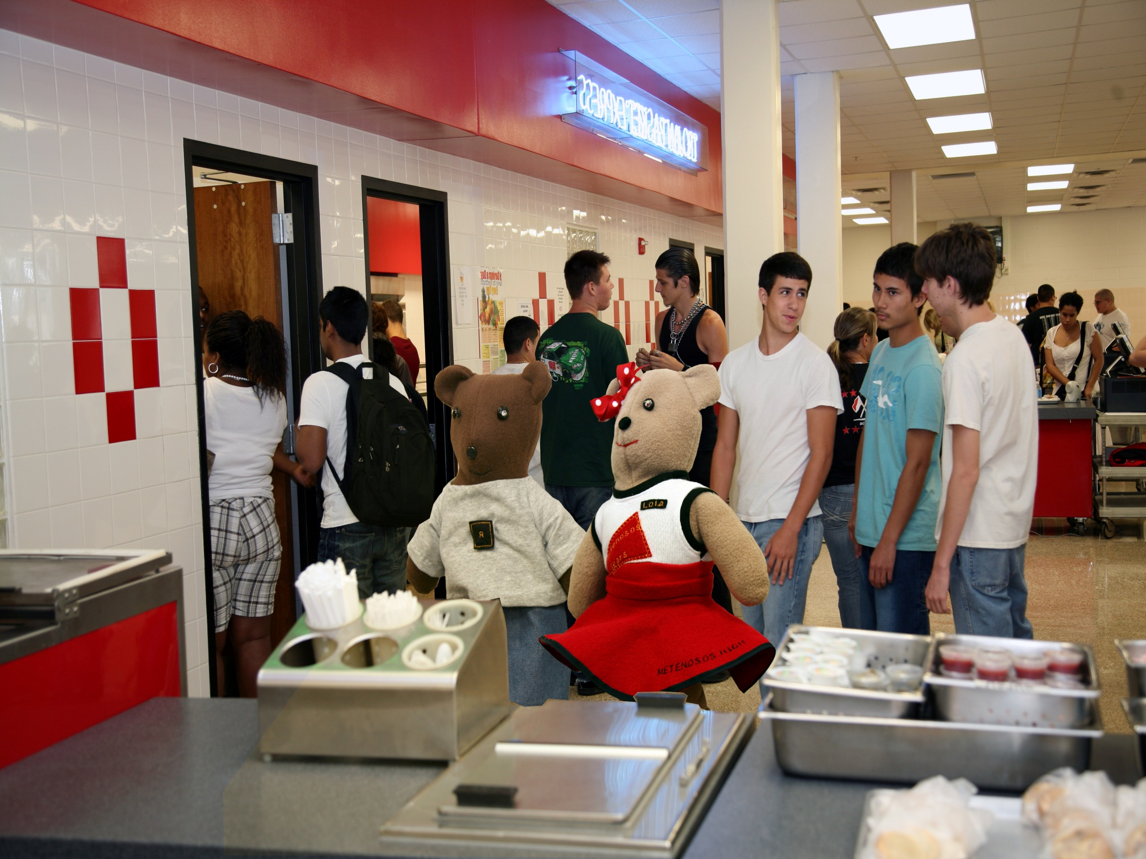
Pos

Slide 17
Lola’s cousin also attends Metenosos High. Her name is Lesle. Lesle is not direct like Lola, she’s very indirect.

Slide 18
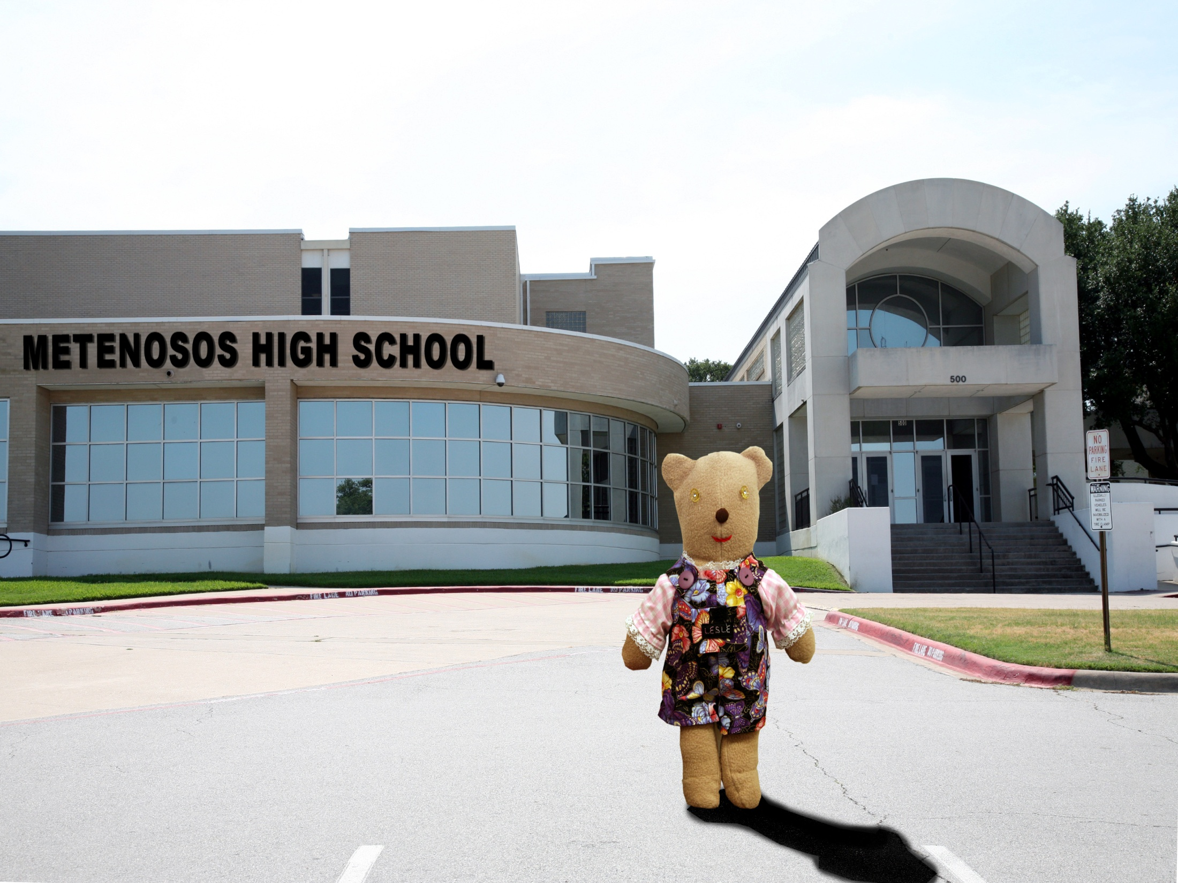

Slide 19
Lesle is not into things like Lola. She’s strictly a people person…or, bear. She will do anything for anyone or say anything to anyone.

Slide 20
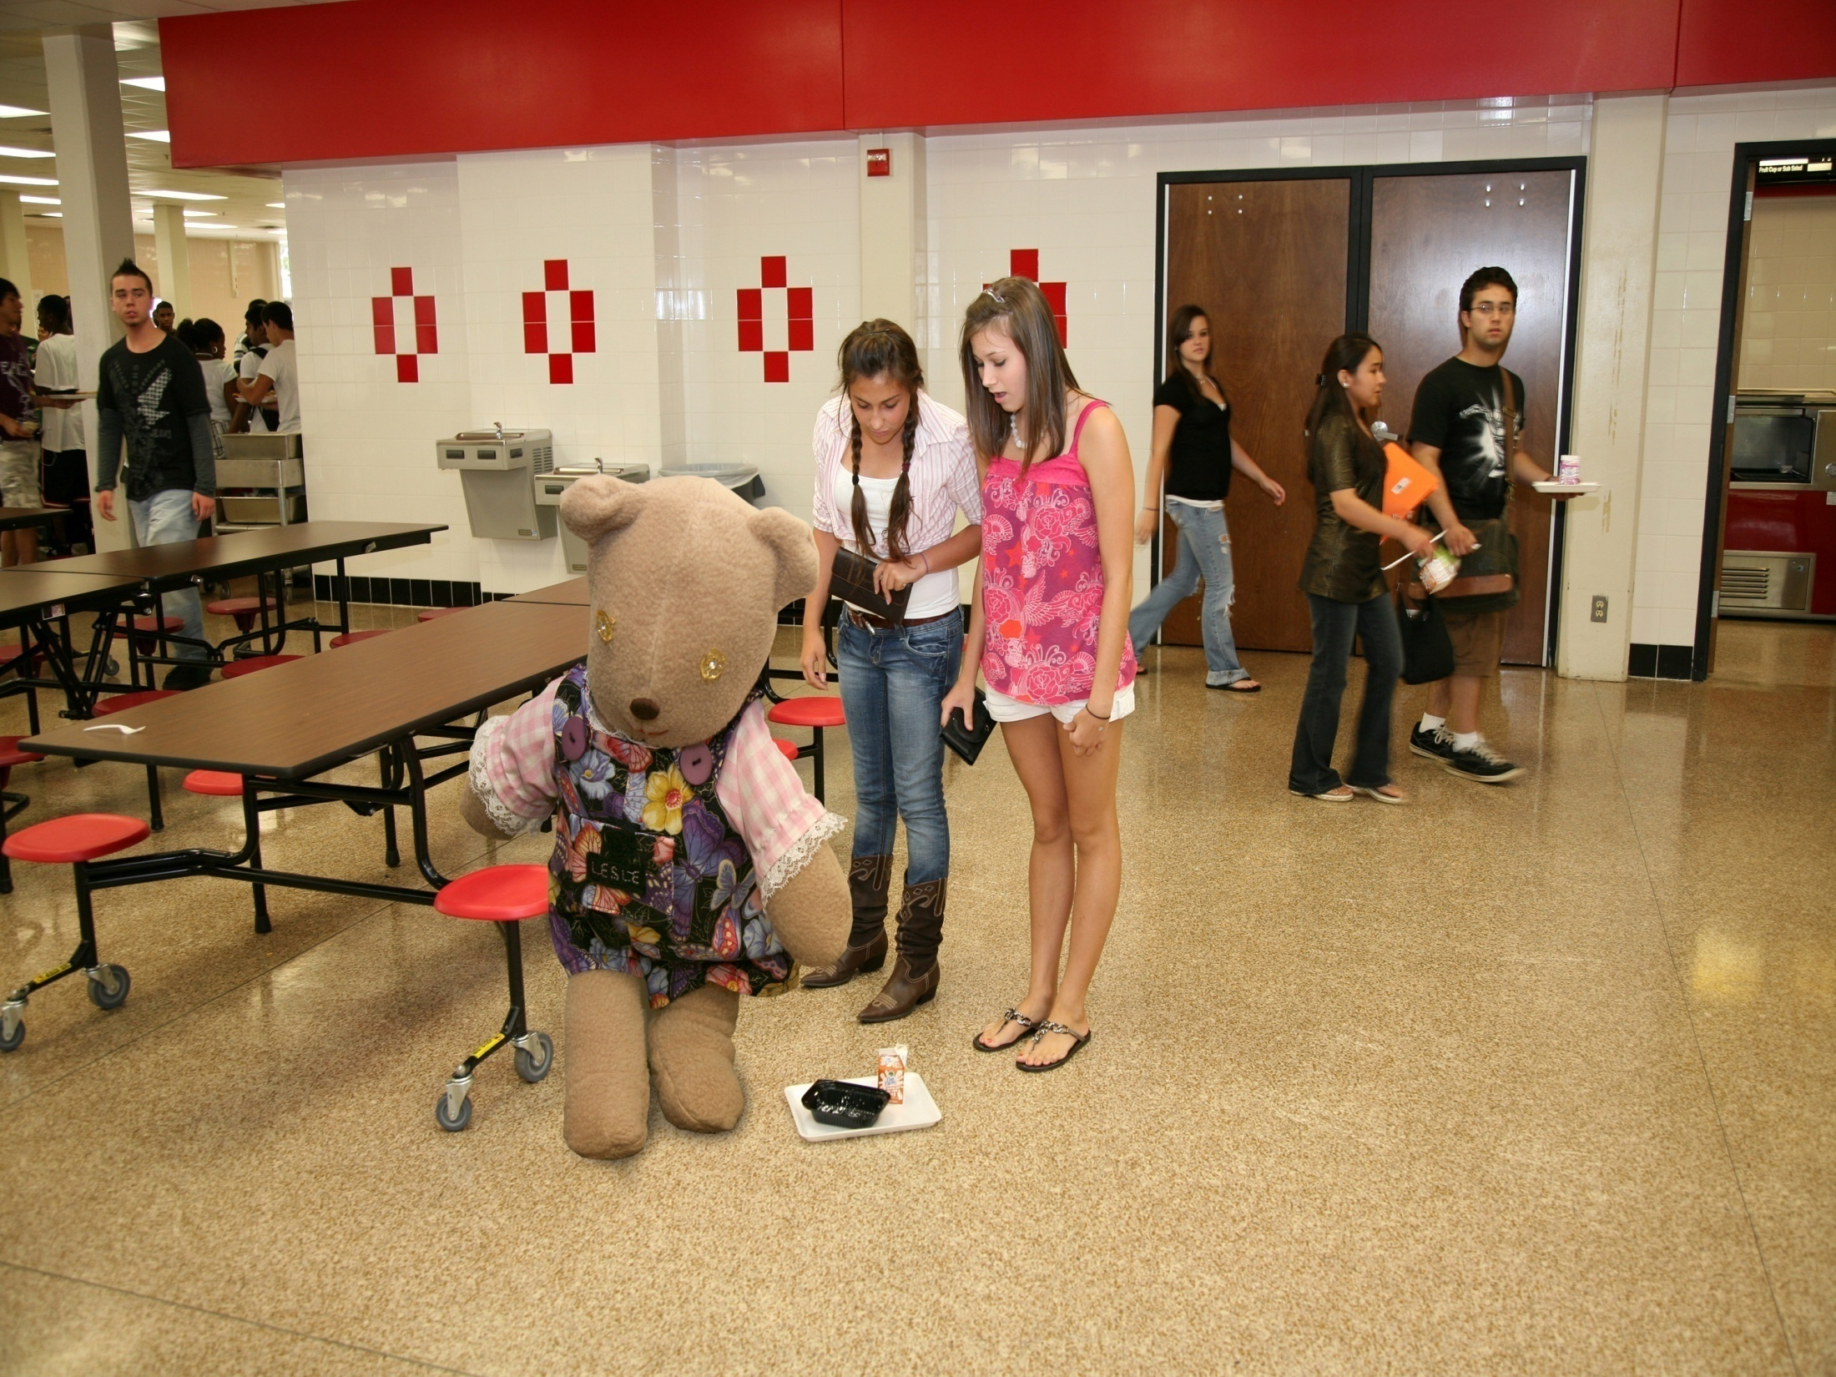

Slide 21
Unlike Lola, Lesle doesn’t want to replace things all the time. Generally she wants to stick around and see how things turn out for people.

Slide 22
Lesle le da la bandeja
a la chica.
Lesle les compra la comida a las chicas.

Slide 23
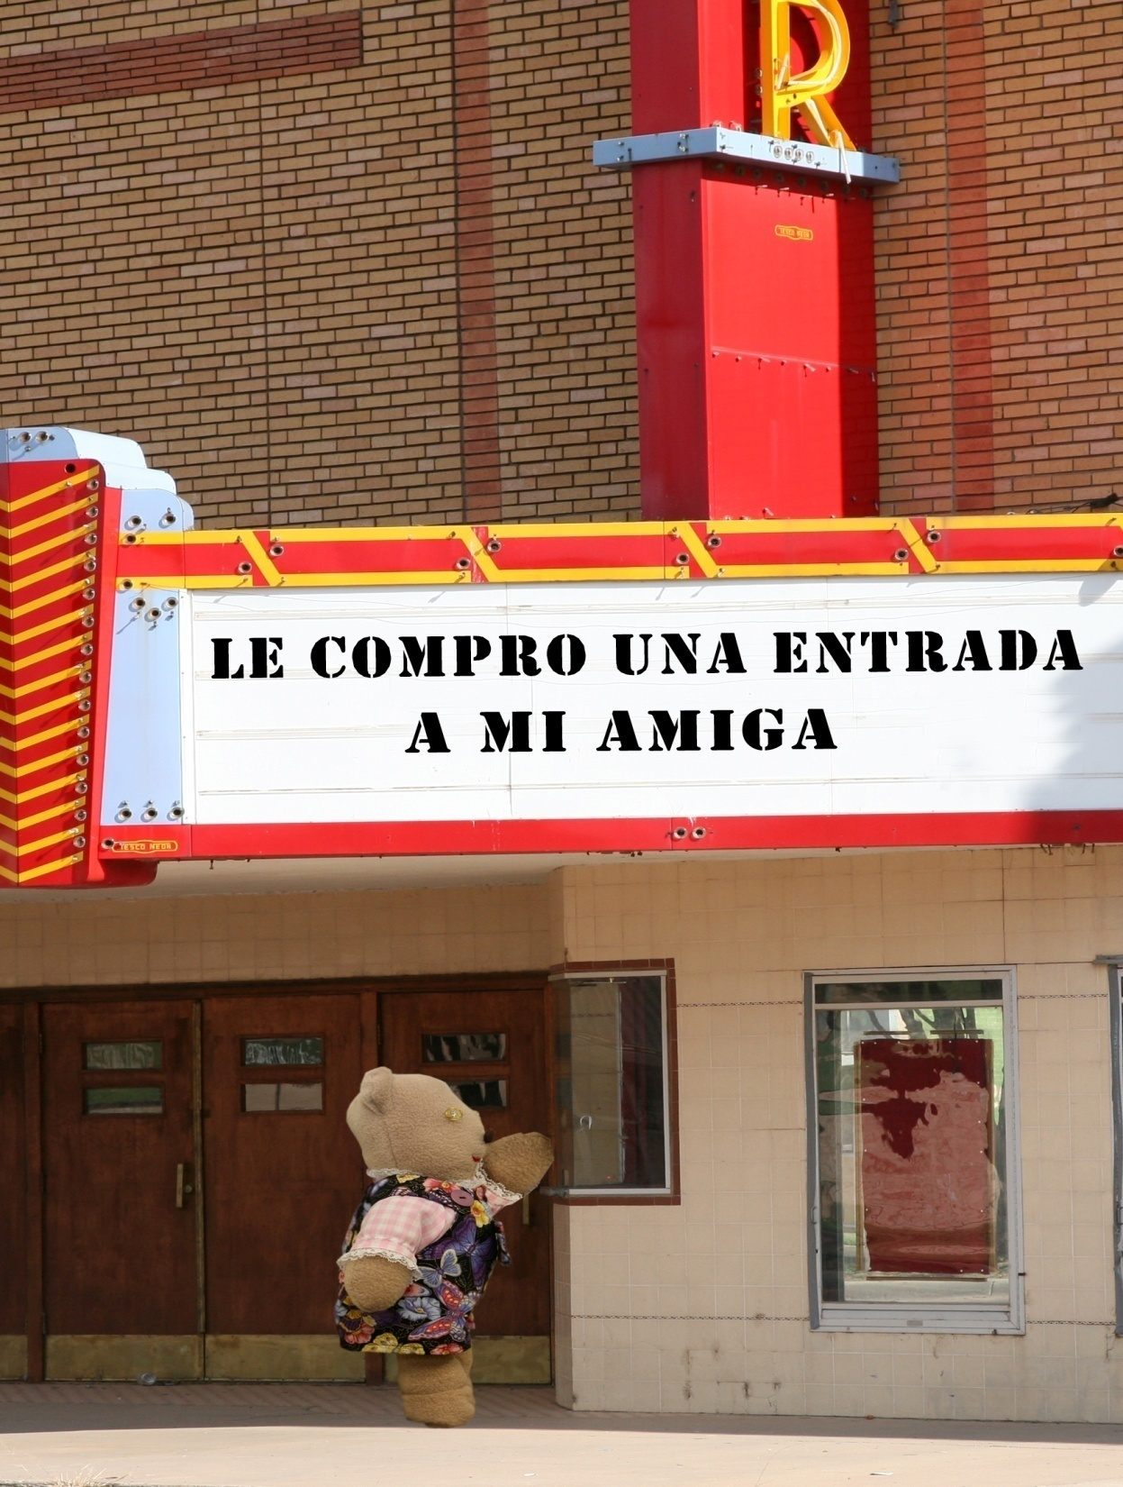

Slide 24
Lesle has the same likes and dislikes as Lola when it comes to the students of Metenosos.

Slide 25
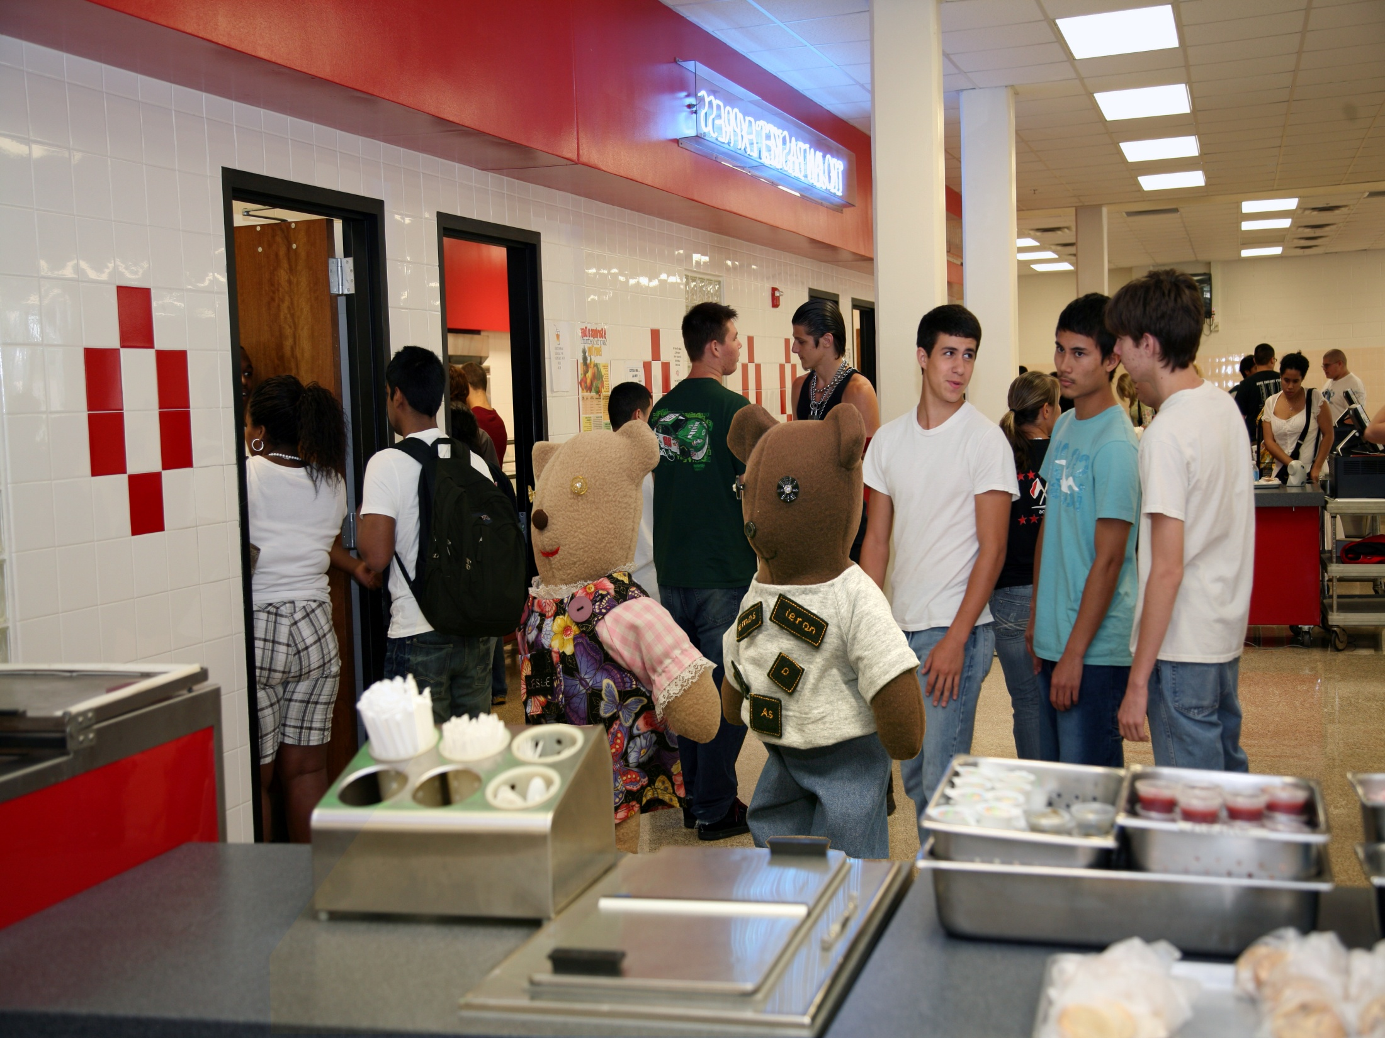
Conj.

Slide 26
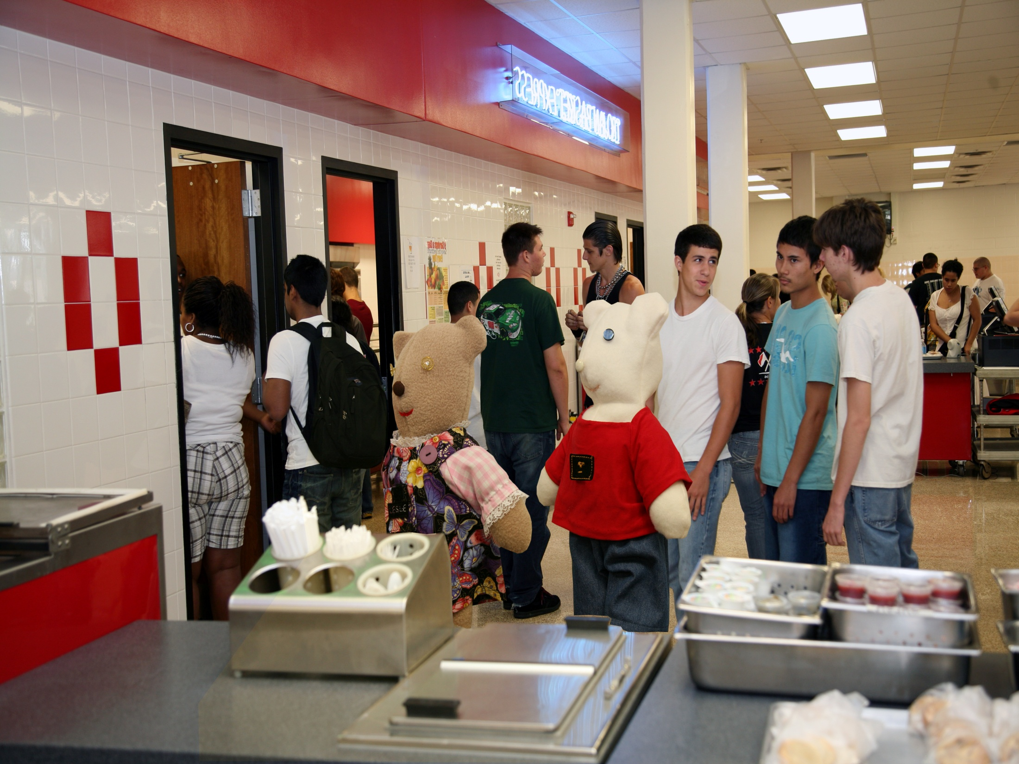
Neg.

Slide 27
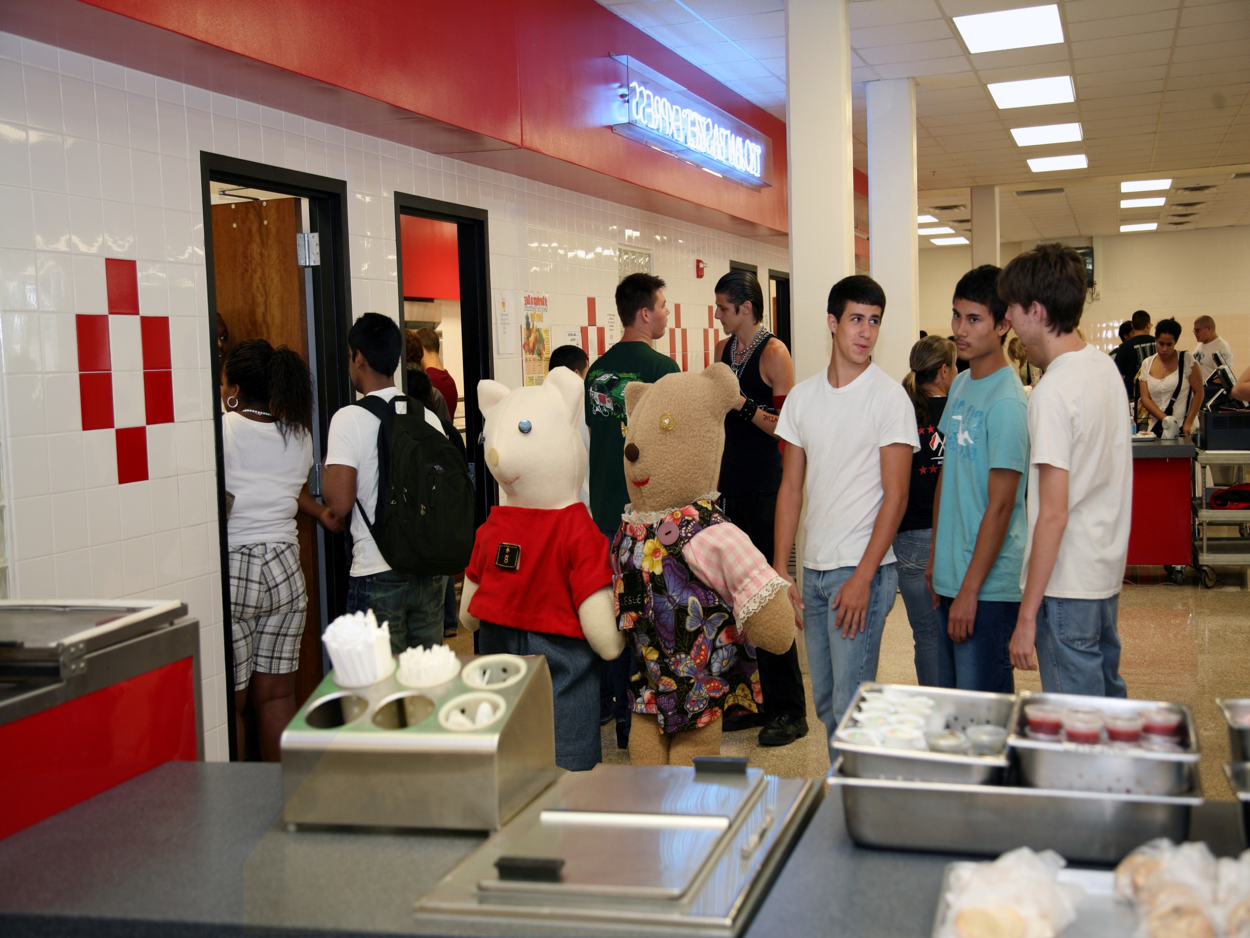
R

Slide 28
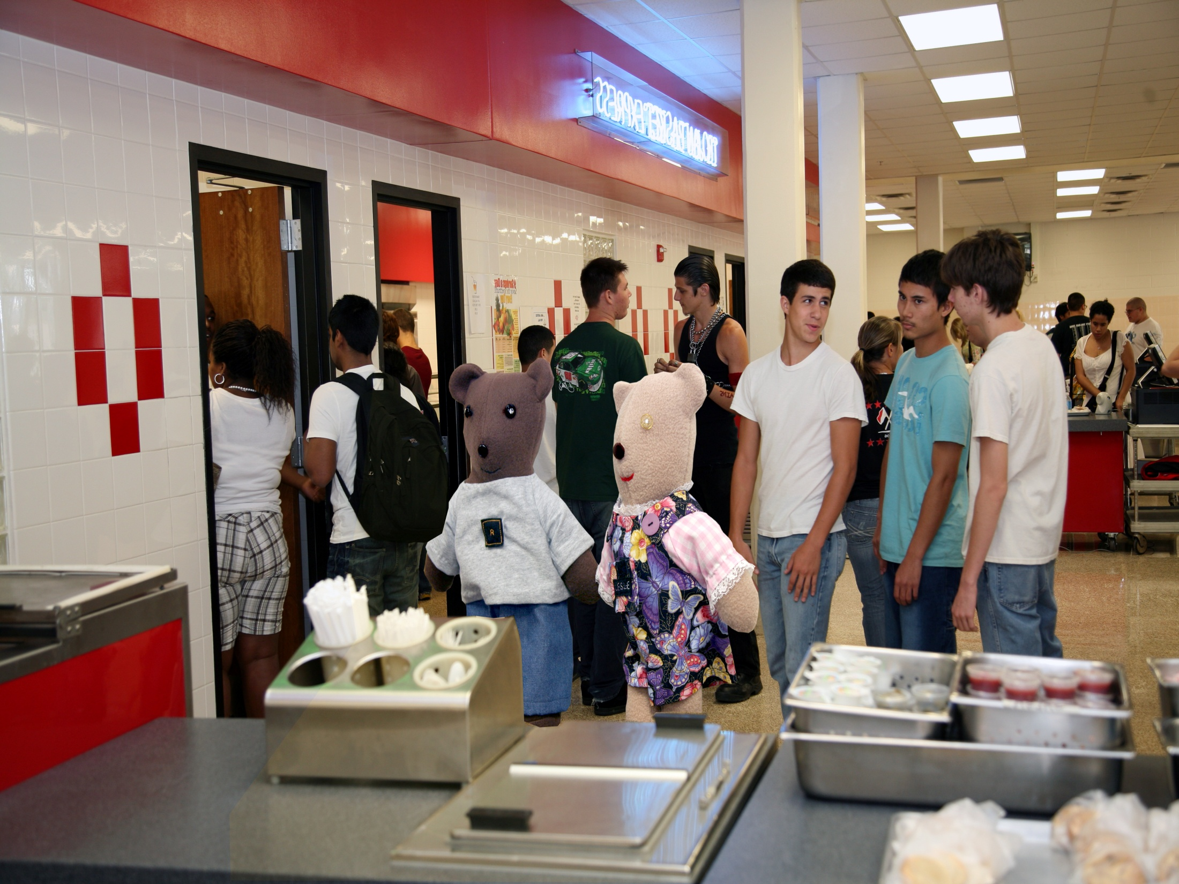
Pos

Slide 29
Lola and Lesle don’t always hang out together, but when they do Lesle always insists on being first. If they happen to be wearing “L” shirts, Lesle will change into her “se” outfit so she doesn’t embarrass the fashion-conscious Lola.

Slide 30
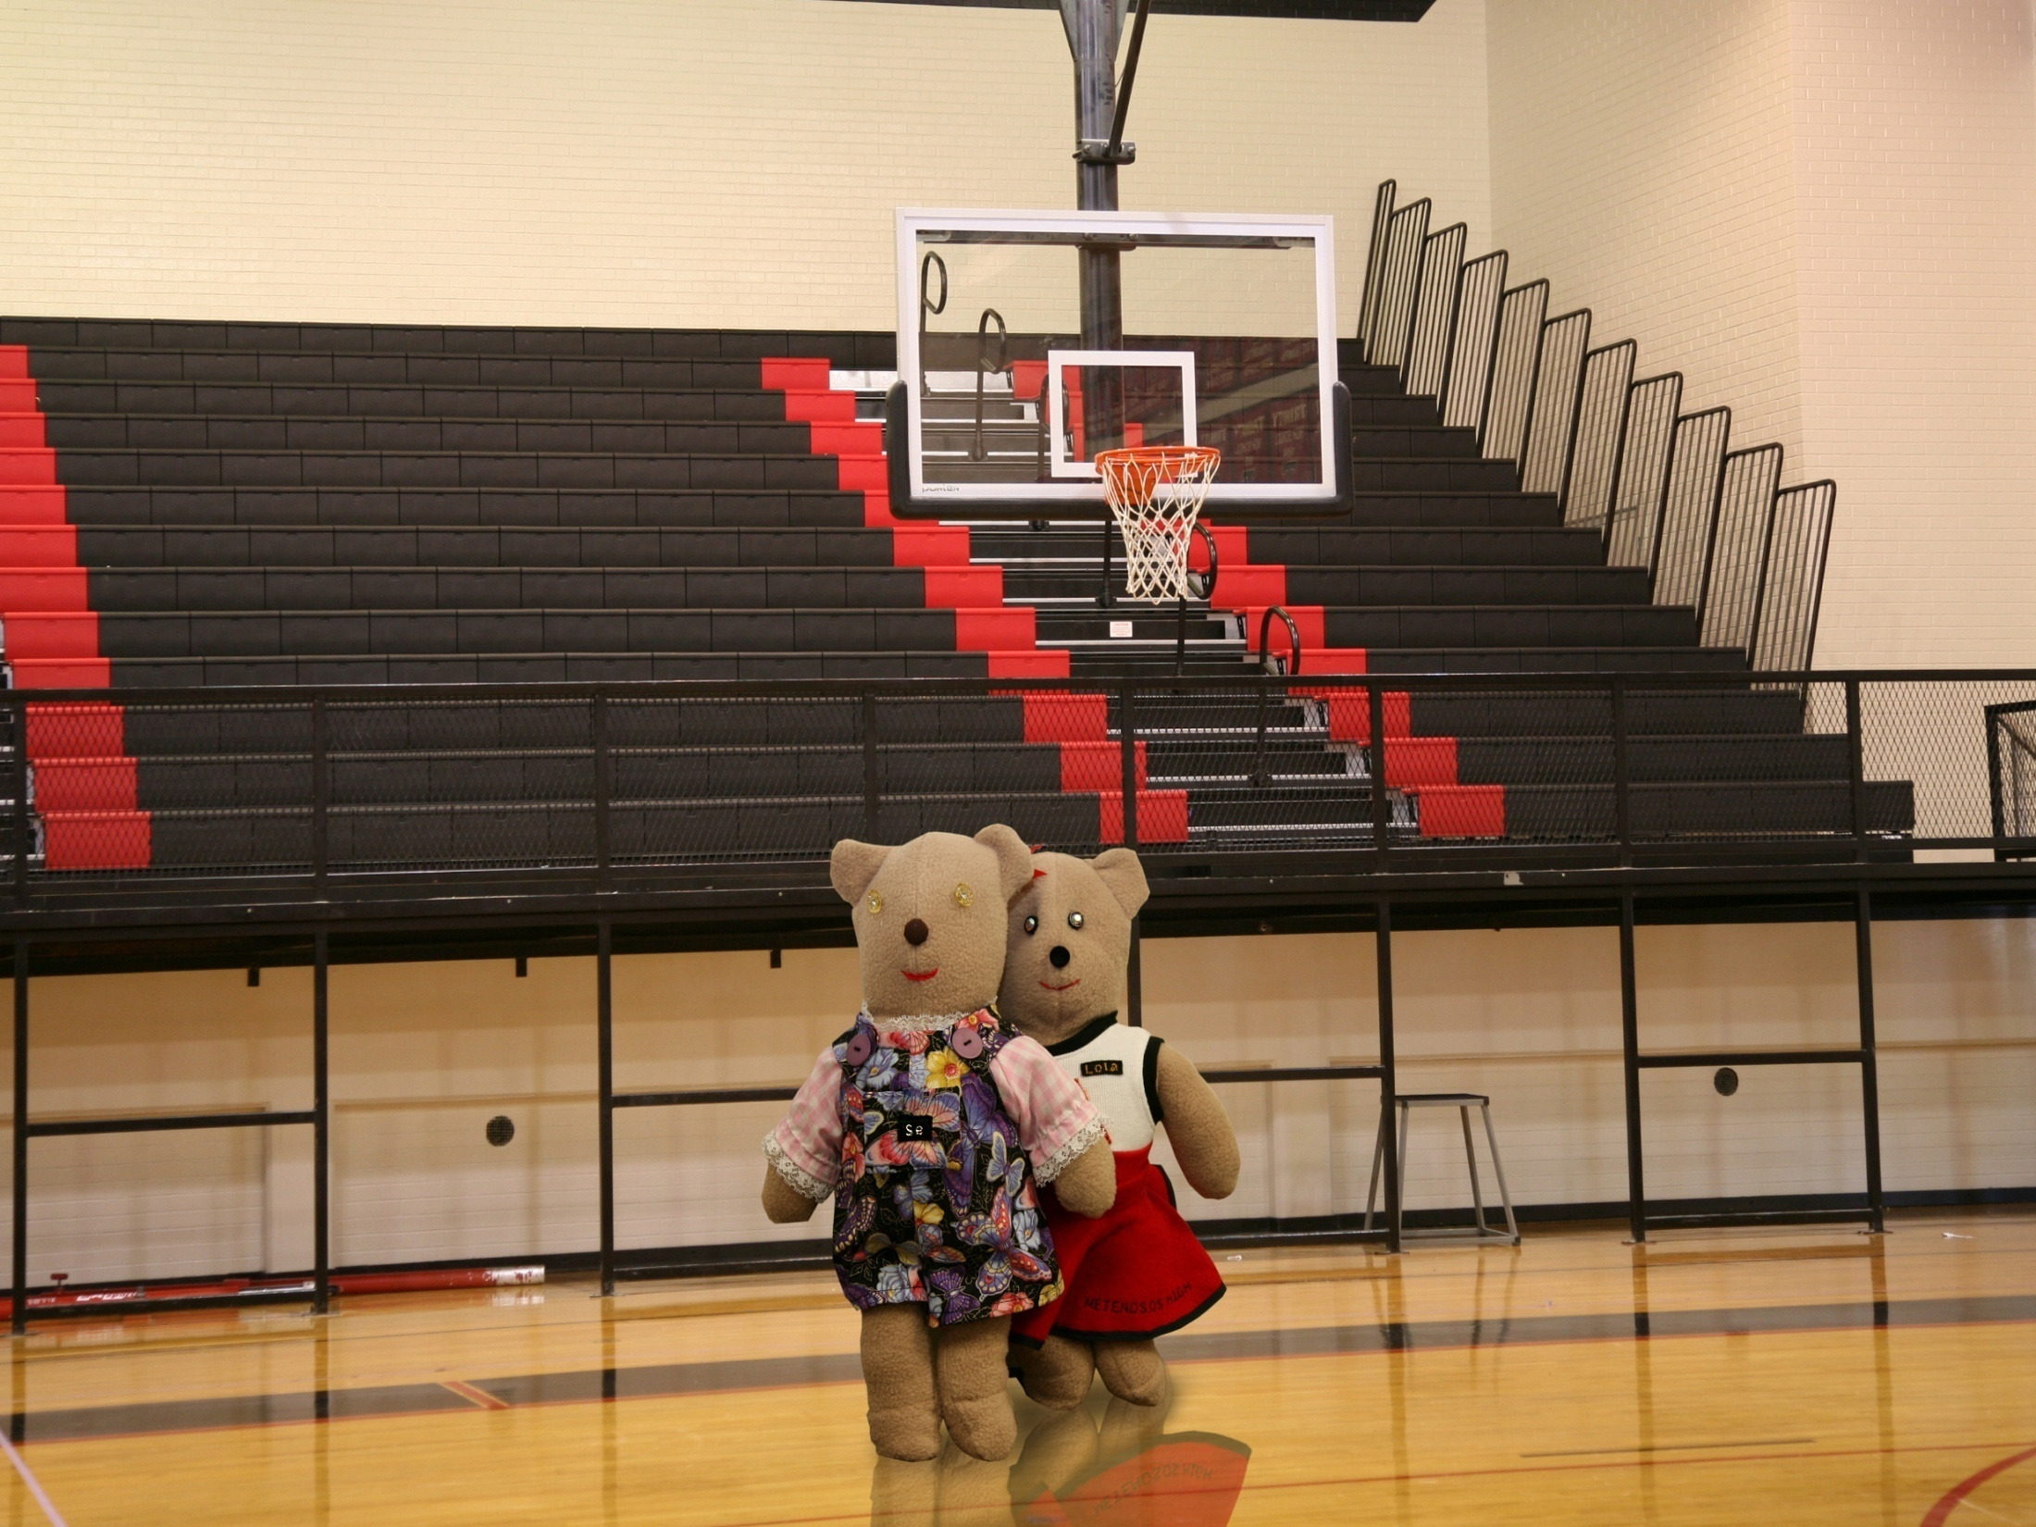

Slide 31
Text by Jason Krieger
Photoshop Wizardry by Sergio A. Delgado

