Slide 1
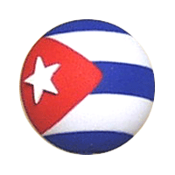
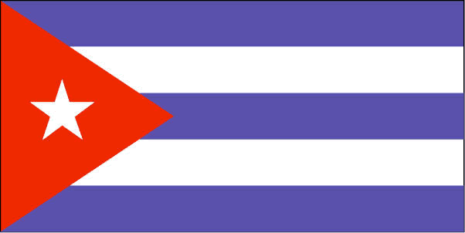
Bienvenidos a Cuba

Slide 2
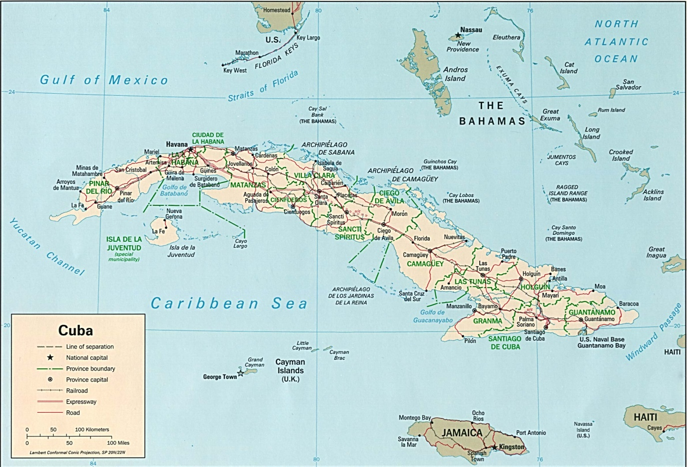
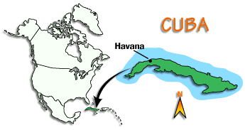
República de Cuba
First, Please enjoy a photo tour

Slide 3
República de Cuba

Slide 4
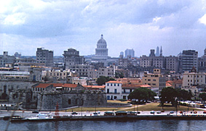
República de Cuba

Slide 5
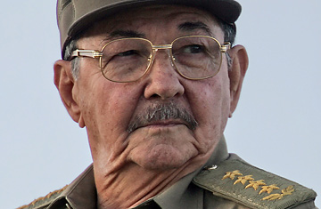
República de Cuba
Cuba is a totalitarian communist state headed by
General Raul Castro

Slide 6
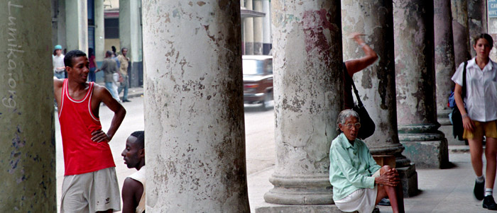
República de Cuba
Cuba is a multiracial society with a population of mainly Spanish and African origins.

Slide 7
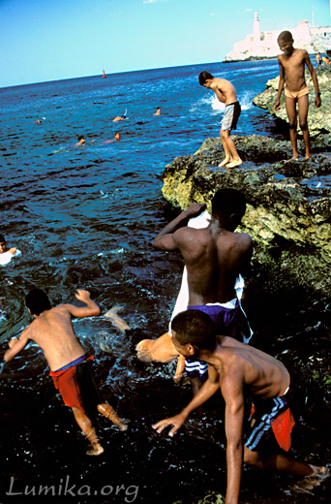
República de Cuba

Slide 8
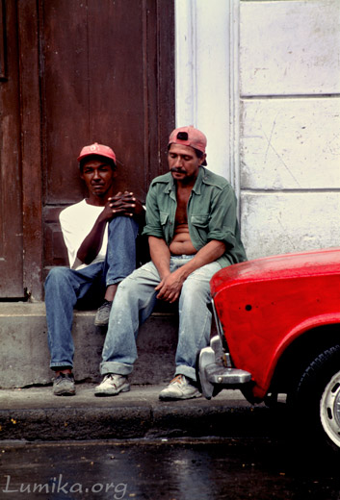
República de Cuba
Money: Cuban Peso
Average monthly salary $20

Slide 9
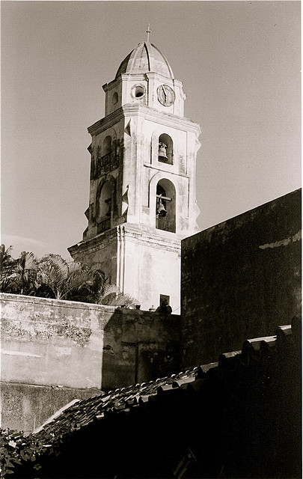
República de Cuba
Cuba was officially an atheist state from 1959 until a constitutional change in 1992

Slide 10
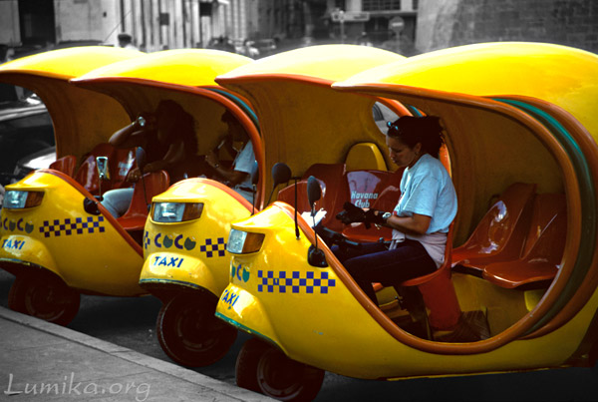
República de Cuba

Slide 11
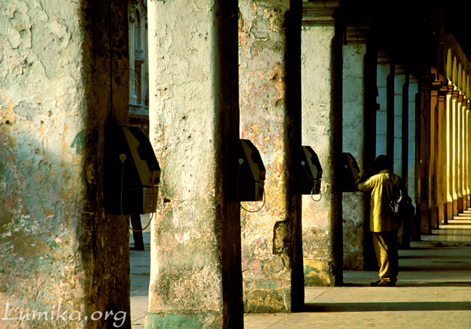
República de Cuba

Slide 12
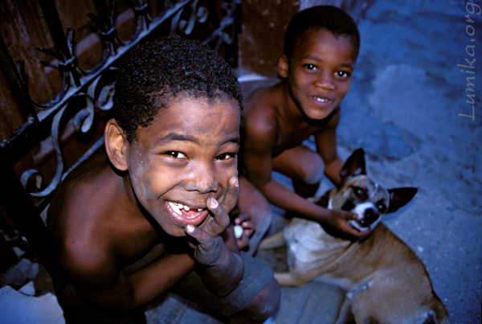
República de Cuba

Slide 13
República de Cuba

Slide 14
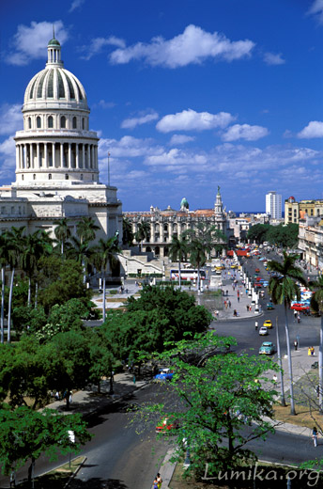
República de Cuba

Slide 15
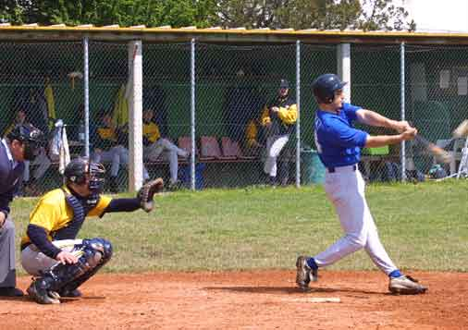
República de Cuba

Slide 16
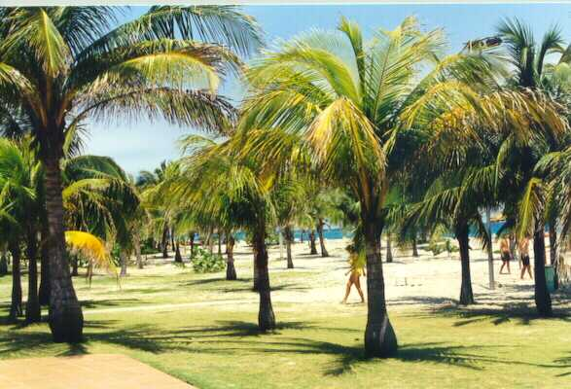
República de Cuba

Slide 17
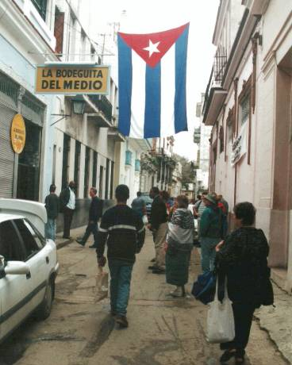
República de Cuba

Slide 18
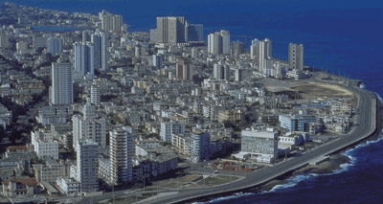
República de Cuba

Slide 19
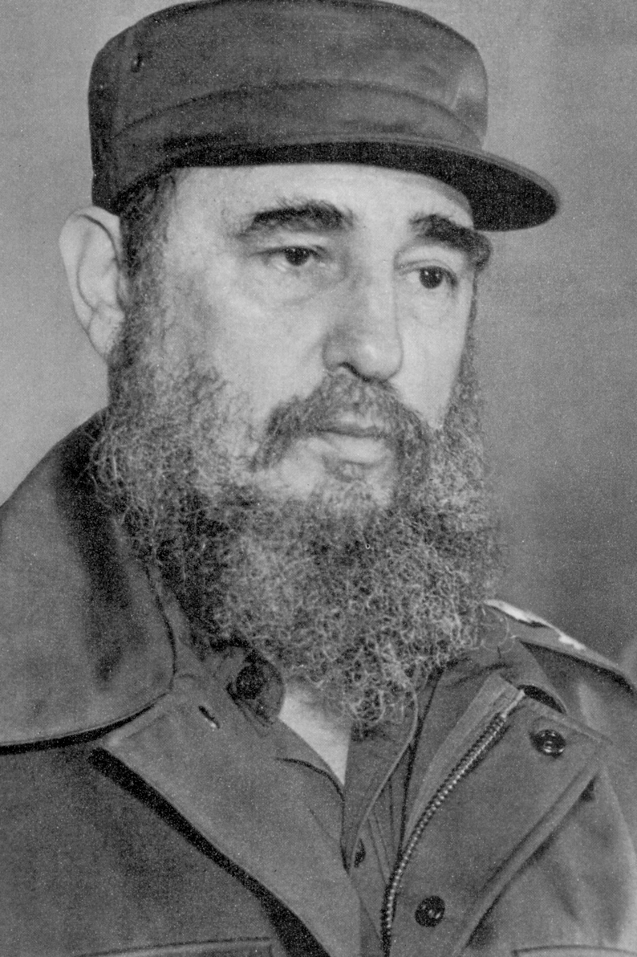
República de Cuba
Castro disavowed Cuba's 1952 military pact with the U.S., confiscated U.S. assets, and established Soviet-style collective farms. The U.S. broke relations with Cuba on Jan. 3, 1961,
and Castro formalized his alliance
with the Soviet Union.
Thousands of Cubans fled the country.

Slide 20
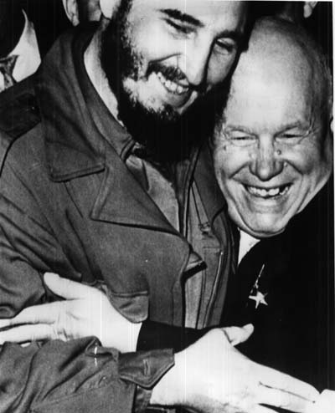
República de Cuba
Fidel Castro (Communist President of Cuba)
and
Nikita Khrushchev (Communist leader of USSR)
Notes:
Union of Soviet Socialist Republics (also known as the USSR or Soviet Union for short

Slide 21
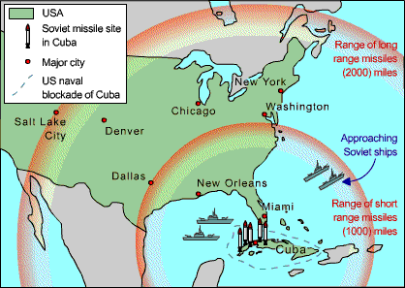
Republica de Cuba

Slide 22
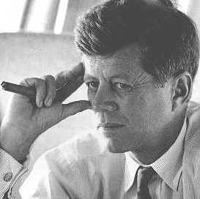
República de Cuba
John F. Kennedy
U.S. President
Notes:
October 15
Photos showed missiles under construction.
October 22
Kennedy concluded to impose a naval quarantine around Cuba. He wished to prevent the arrival of more Soviet offensive weapons on the island. Kennedy eventually ordered low-level reconnaissance missions once every two hours.
October 25
Kennedy pulled the quarantine line back and raised military readiness to DEFCON 2.
October 26
EX-COMM heard from Khrushchev in an impassioned letter. He proposed removing Soviet missiles and personnel if the U.S. would guarantee not to invade Cuba
October 27
A U-2 was shot down over Cuba and EX-COMM received a second letter from Khrushchev demanding the removal of U.S. missiles in Turkey in exchange for Soviet missiles in Cuba.
October 28
Khrushchev announced that he would dismantle the installations and return the missiles to the Soviet Union

Slide 23
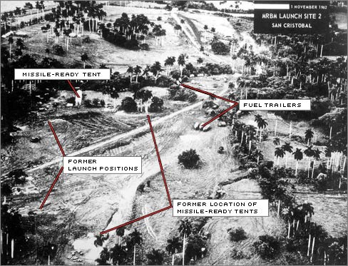
Oct 15
Republica de Cuba

Slide 24
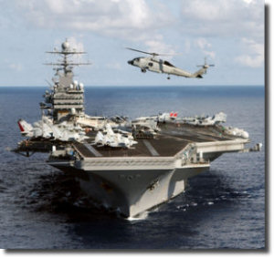
República de Cuba
Oct 22

Slide 25
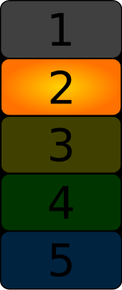
República de Cuba
Oct 25

Slide 26
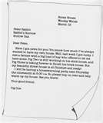
República de Cuba
Oct 26

Slide 27
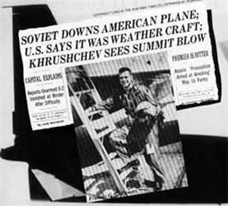
República de Cuba
Oct 27

Slide 28
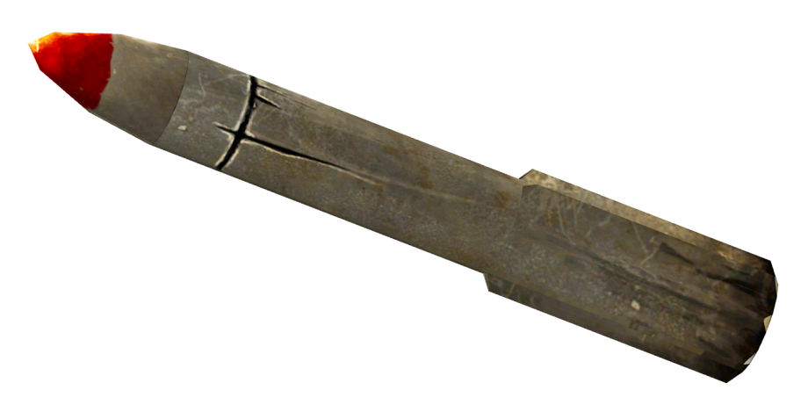
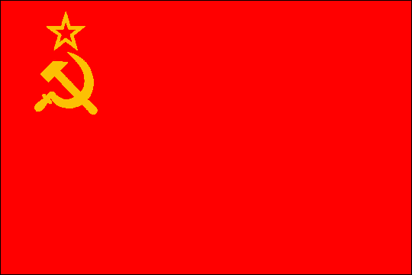
República de Cuba
Oct 28

