Slide 1
Costa Rica
Español II
Unidad 1

Slide 2
«Tico»
Es el nombre del equipo de fútbol.
También es el nombre de los costarricenses.

Slide 3
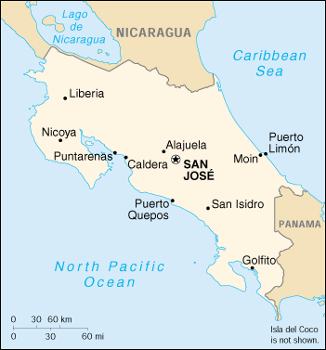
Costa Rica lies at the intersection of two continents and two oceans. San José, the capital of Costa Rica and Central America’s most cosmopolitan city, has a population of approximately 278, 000 people, many of who speak English as a second language. San José is also known as “Chepe,” an endearing nickname for the name José.

Slide 4
Muy intersante…
Los costarricenses dicen «pura vida» para…
Saludar a amigos
Dar gracias
Responder a «¿Cómo estás?»

Slide 5
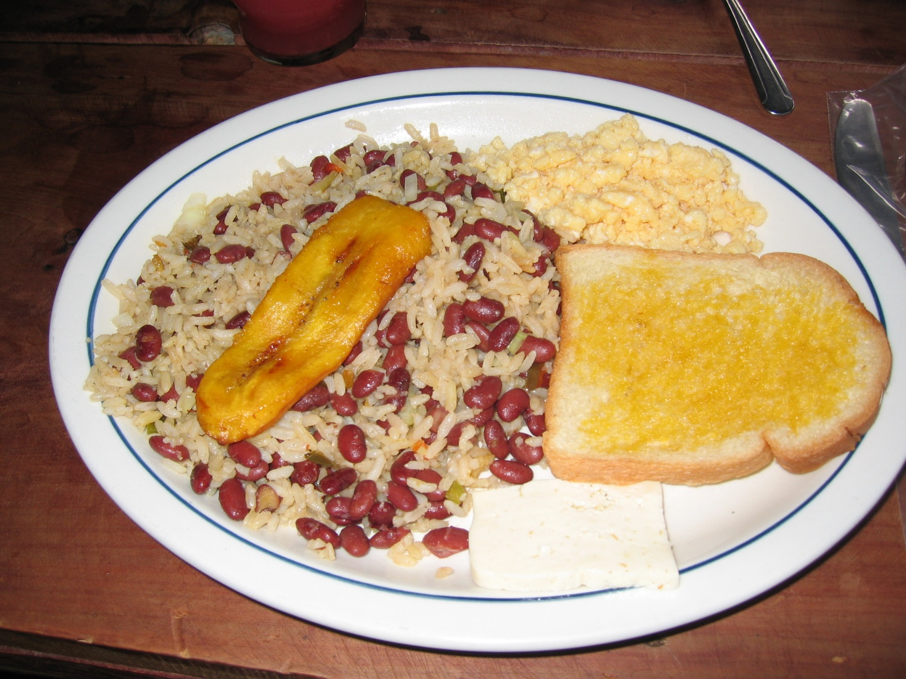
Desayuno en Costa Rica
Gallo Pinto con huevos revueltos, pan tostado, banana frita y queso blanco.

Slide 6
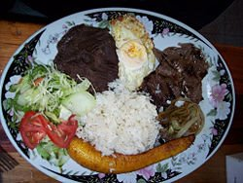
Almuerzo en Costa Rica
Casado is usually served with rice, black beans, fried plantains, a salad and a meat usually either pork, fish, chicken or beef. The best place to find this rather filling, delicious and cheap meal is in one of your neighborhood "Sodas." These Sodas are very small restaurants with a tin awning and some tables. A casado for lunch with drink will set you back about 1500-2000 colones or about $2.50 to $3.00.

Slide 7
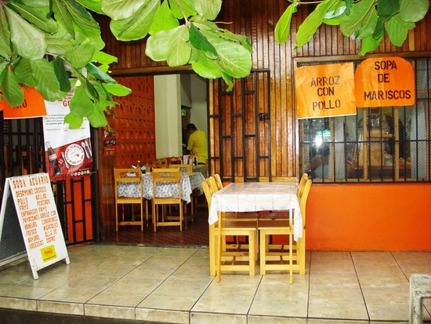

Slide 8
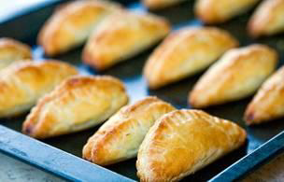
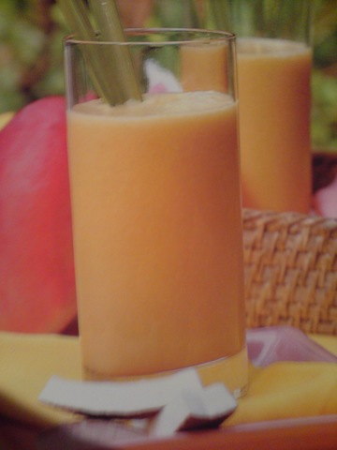
Meriendas en Costa Rica
Empanadas
Refrescos

Slide 9
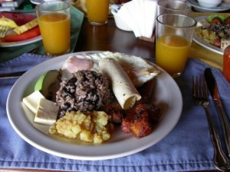
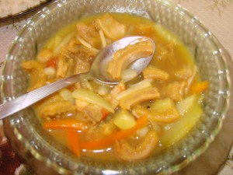
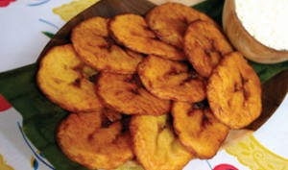
Cena en Costa Rica
Mondongo

Slide 10
¿Qué hora es en Costa Rica?
Muy intersante…
Costa Rica is the same as Nebraska except no Daylight Savings time. If we are on Daylight Savings time we are at 12 and they are at 11.
Notes:
Costa Rica is the same as Nebraska except Costa Rica does NOT use Daylight Savings time. The are on Central time. If we are on Daylight Savings time, we are at 12 and they are at 11.

Slide 11
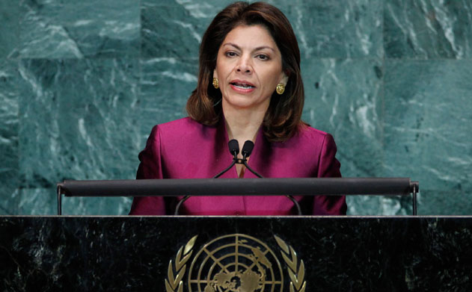
El gobierno
Republic – people elect the president
Presidents serve 4 year terms – 2 vice presidents
Laura Chinchilla Miranda – 1st female president

Slide 12
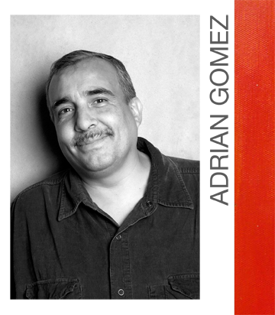
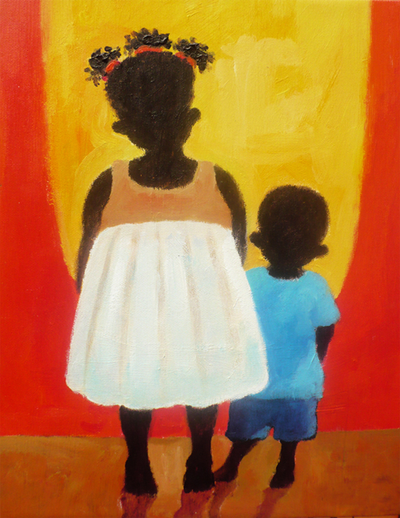
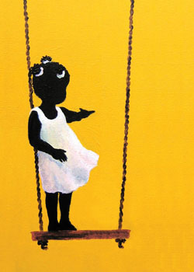
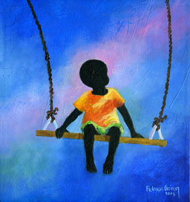
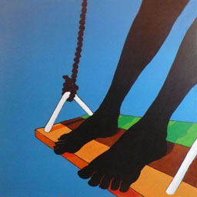
Un tema frecuente del artista Adrián Gómez son los niños (children) y los columpios (swings).
Los pinturas de Adrián Gómez reflejan la esencia de pura vida.

Slide 13
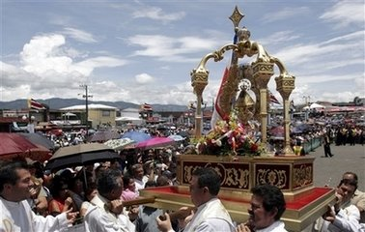
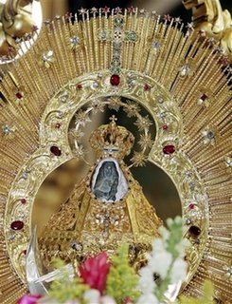
Día de fiesta
El 2 de agosto
Día de la Virgen de Los Angeles (Virgin of Los Angeles Day) honoring St. Mary, Patron Saint of Costa Rica.
La Negrita

Slide 14
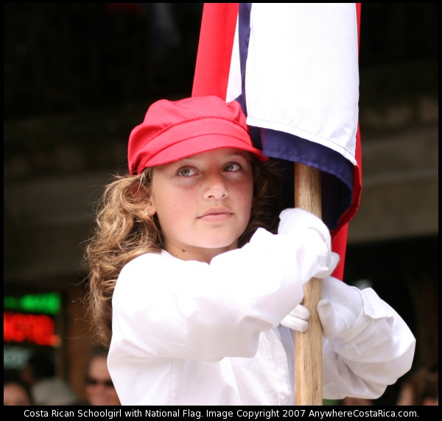
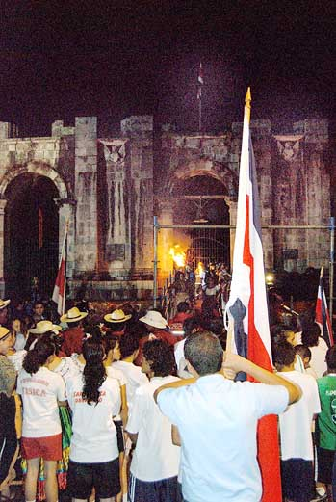
Independence Day
Costa Rica gained independence from Spain on the same day as the rest of Central America on
Sept. 15, 1821
Notes:
The nationwide celebration starts with parades, traditional dancers, and street parties and culminates with the arrival of the Freedom Torch in Cartago (delivered from Nicaragua by relay runners) when everyone in the country stops and simultaneously sings the national anthem. Children later enjoy faroles parades where they carry small lanterns through their towns

Slide 15
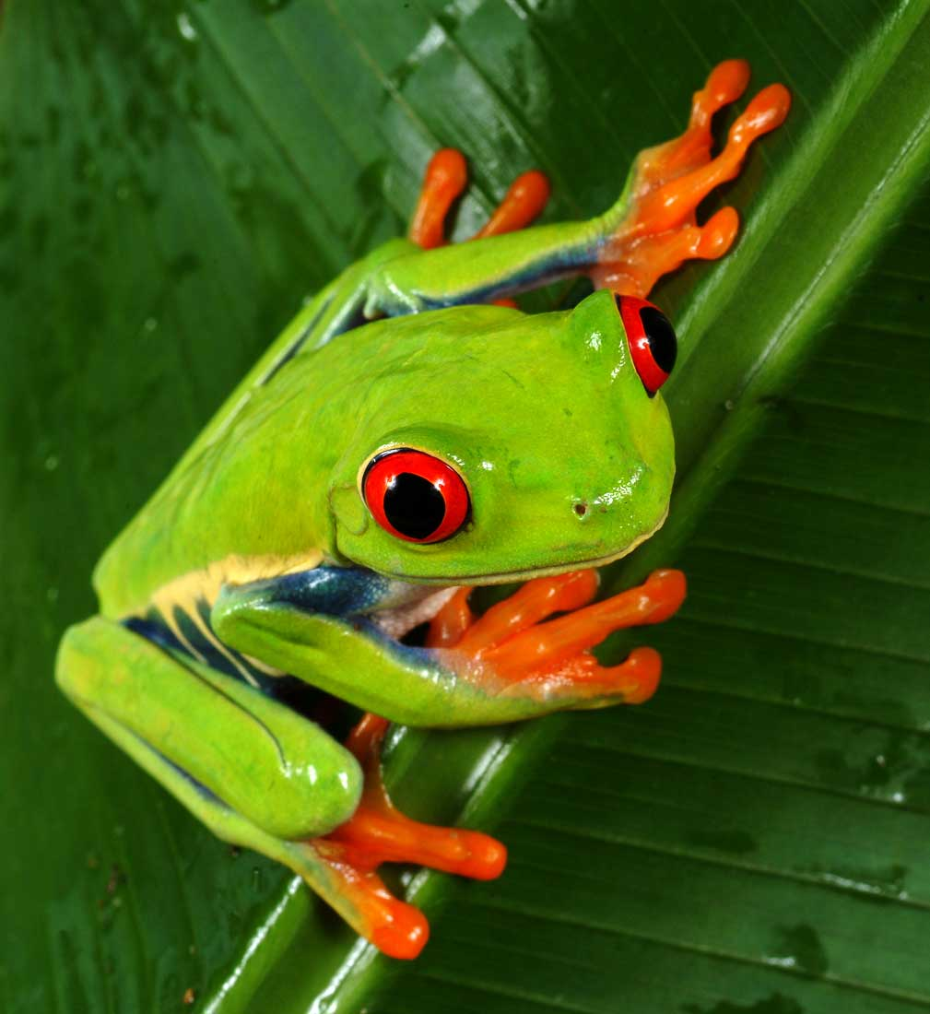
Muy intersante…
Tree Frog is unofficial symbol of Costa Rica

Slide 16
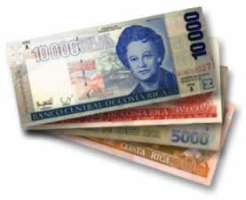
The unit of currency in Costa Rica is called the colón, which is divided into 100 céntimos. Sometimes the colón is called a peso.
CHANGING MONEY:
Always remember to bring your personal identification and passport.
Exchanging money is best done at the airport money counters. The services are fast and efficient, and you will have currency before you hit the streets.
If this is not possible, the Airport Bank in San José offers good rates.
Just keep in mind that it is more difficult to change dollars to colónes in rural areas.
BANKS:
San José banks are usually open from 9 am to 3 PM.
Public banks are usually crowded.
Private banks can be a faster alternative.

Slide 17
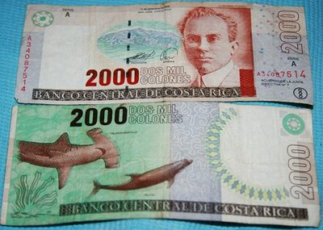
El dinero
colón
US $1 = Ȼ = 501
Costa Rica's minimum wage ranges from 107,883 Costa Rican colones a month for domestic employees to 397,665 colones for university graduates
$215 - $793
per month

Slide 18
Literacy Rate
age 15 and over who can
read and write
around 95 %

Slide 19
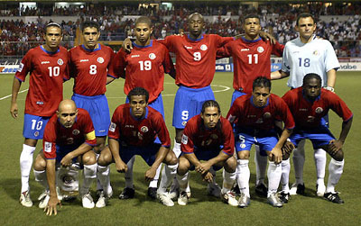
Un deporte popular

Slide 20
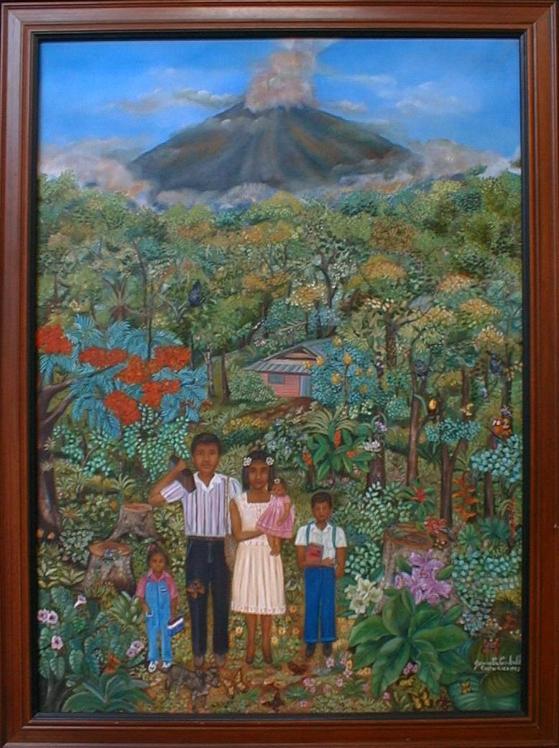
Familia en el Volcán Arenal (1989) by Jeannette Carballo
En esta pintura, la artista costarricense Jeannette Carballo presenta a una familia típica del campo (countryside). El padre tiene un radio para escuchar las noticias (news). La madre tiene en los brazos a una de sus hijas. La otra hija tiene un libro. El niño tiene sus libros y cuadernos para ir a la escuela. ¡La familia está preparada para empezar el día!

Slide 21
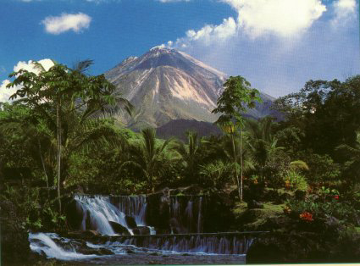
Aguas Termales El Tabacón en Arenal está cerca de un volcán.
The hot springs of Tabacón are due to the volcano, Arenal which is ¾ of a mile away. A major volcano in Costa Rica, Arenal lay dormant for 400 years—then erupted in 1968. Today, visitors float in warm waters near its base while watching giant fiery boulders tumble down its sides.

Slide 22
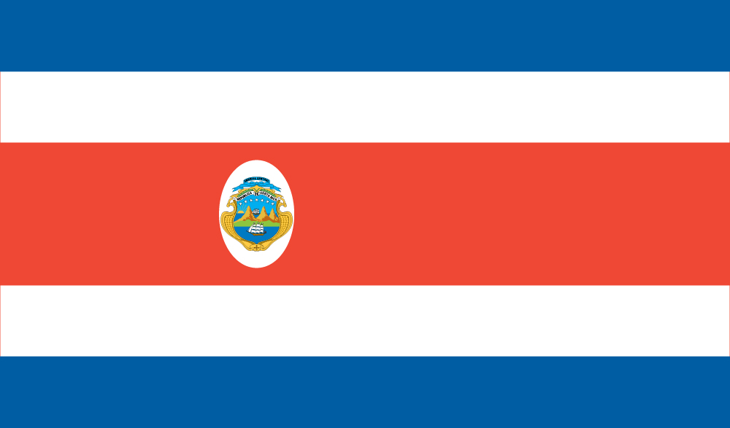
Each color represents important aspects of Costa Rica:
Blue means the sky, opportunities at reach, intellectual thinking, perseverance to accomplish a goal, infinite, eternity, and ideals of the religious and spiritual desires. White means clear thinking, happiness, wisdom, power and beauty of the sky, the driving force of initiatives to search for new endeavors, and the peace of Costa Rica. Red means the warmth of Costa Rican people, their love to live, their blood shed for freedom, and their generous attitude.

Slide 23
