Slide 1
Argentina

Slide 2
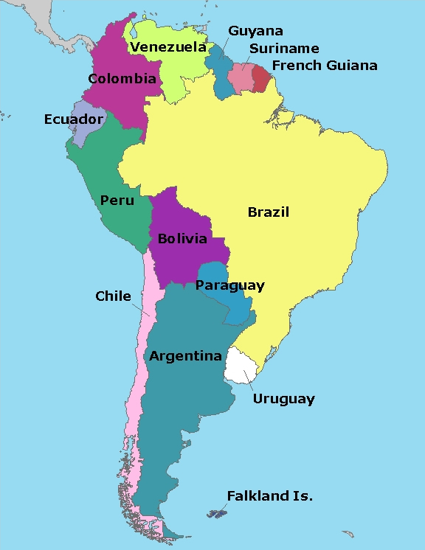
Ocèano Atlántico
Ocèano Pacífico

Slide 3
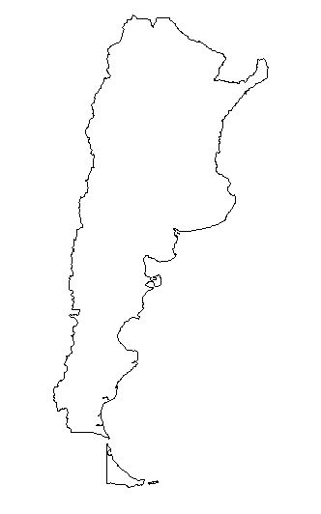
XX
XX
XX
XX
XX
XX
XX
XX
XX
XX
X
X
XX
Mendoza
Rosario
Buenos Aires
With brown Xs drawn in and label (Cordillera de los) Andes
Mar del Plata
Tierra del Fuego

Slide 4
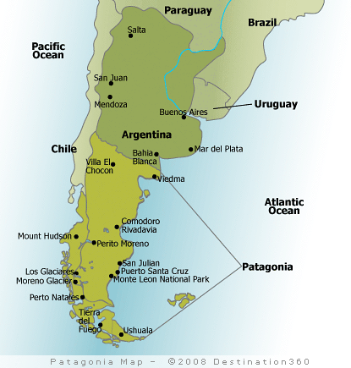
Shade in and label
Pampas and Patagonia
XX
XX
XX
X
X
X
X
XX
X
X
X
X
XX
Pampas
Patagonia

Slide 5
La bandera

Slide 6
Argentina’s Independence
July 9, 1816 is when Argentina declared it’s Independence from Spain.
This is the Coat of Arms for Argentina.
The rising sun=birth of a new nation
The blue and white background=the clear sky and the Río de la Plata
The laurels=Argentina’s successful struggle for freedom
The joining hands=solidarity of the Argentine people
The staff=the power of the people’s union.
The red hat is just red but does exemplify the motto En Unión y Libertad (In Union and Liberty).

Slide 7
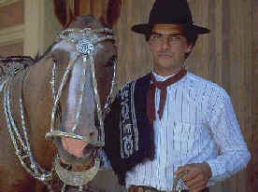
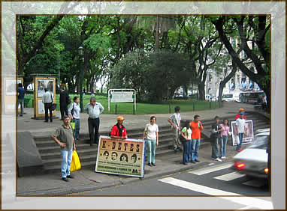
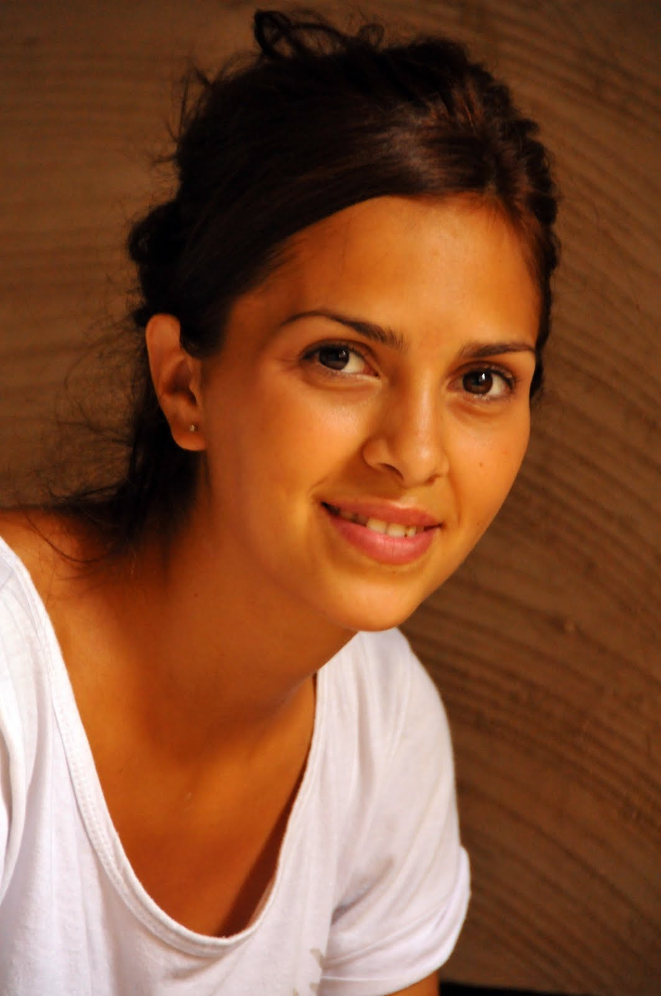
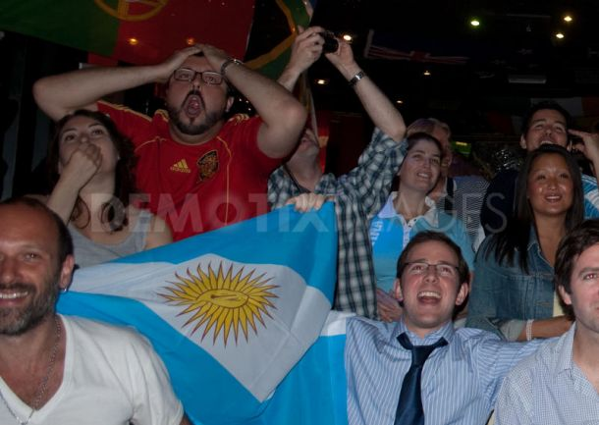
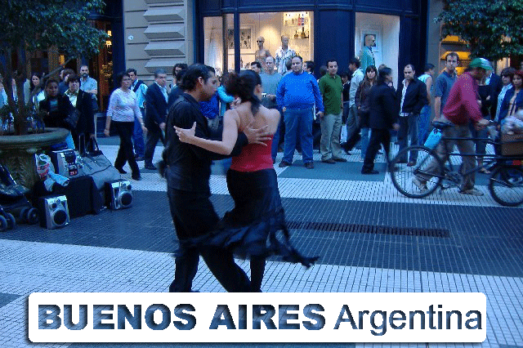
People from Argentina are called argentinos/as

Slide 8
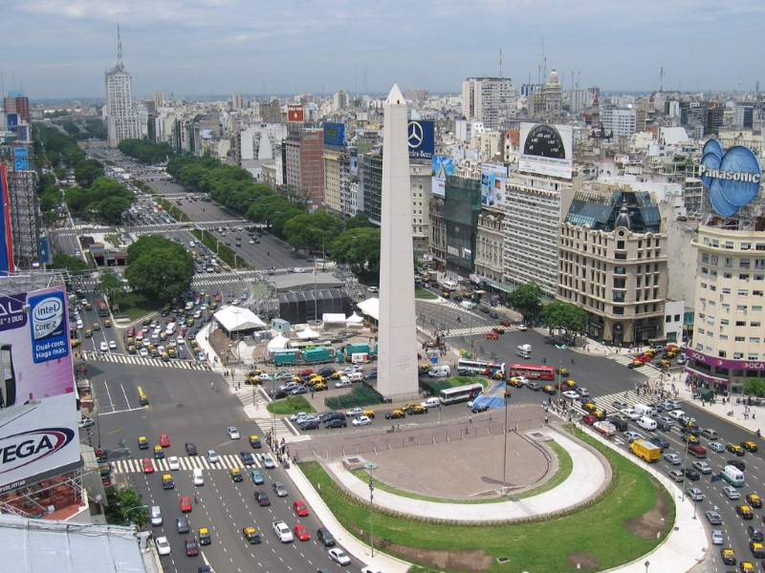
Buenos Aires—the Capital

Slide 9
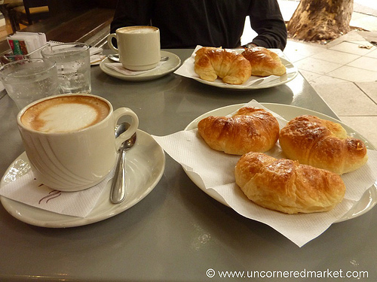
El desayuno
Strong coffee, toast with butter, jam, or a spread known as dulce de leche, pastries and fruit, juice

Slide 10
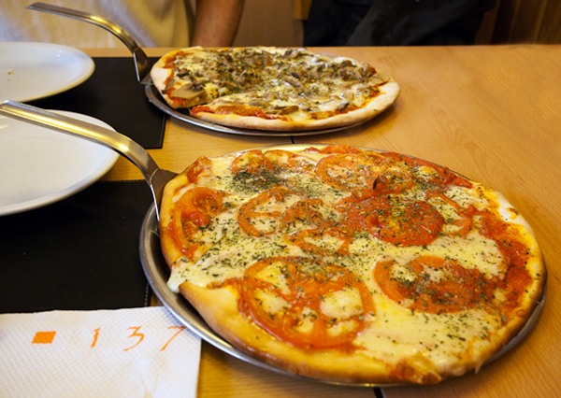
El almuerzo
Consists of meat dish, pasta, or pizza.
A lot of Spanish and European influence in the food.

Slide 11
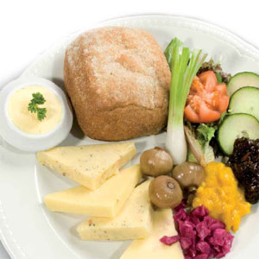
La merienda
Cheeses, fruits, vegetables, pastries

Slide 12
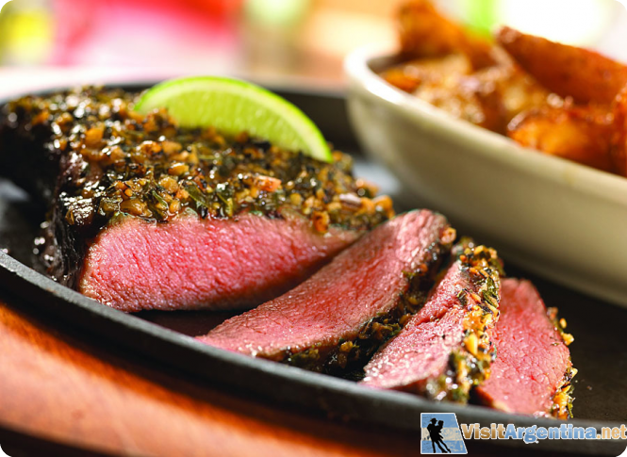
La Cena
*country is famous for its grass fed cattle and the gauchos who work the open range raising these animals. *meat is eaten with very little seasoning *most traditional way to eat meat in Argentina is the asado, or barbecue

Slide 13
El Gobierno
Argentina is a Republic. President is Head of State and Head of Government.
The Current President is Cristina Fernández de Kirchner. She is the first elected female President and was re-elected this month--October 2011.

Slide 14
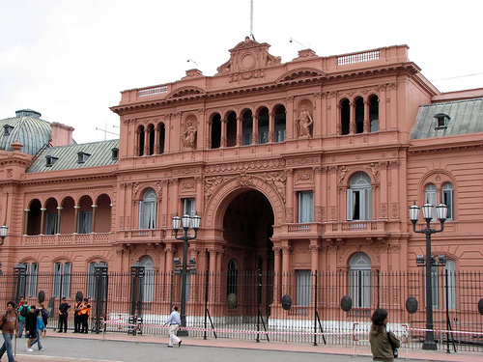
La casa rosada

Slide 15
Una persona famosa
Justo Lamas
singer

Slide 16
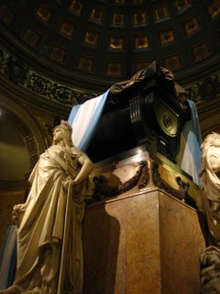
Día de fiesta
El 17 de agosto
Día de San Martín
Helped liberate
Argentina
from Spain

Slide 17
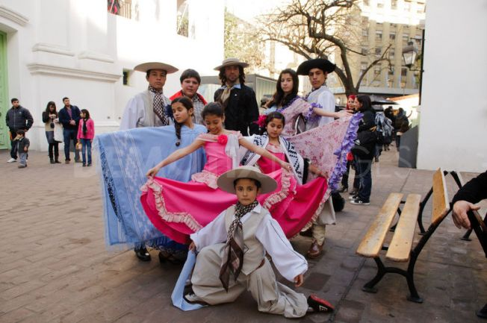
Día de Independencia
El 9 de julio, 1816

Slide 18
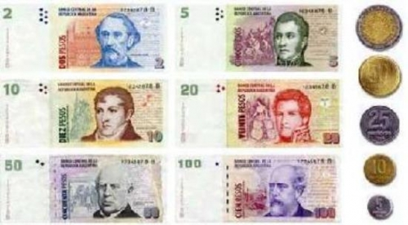
El dinero
peso argentino
US $1 = Arg $4.24
Notes:
http://fififinance.com/symbols/USDARS.FOREX?q=1

Slide 19
Argentina's minimum wage rate is 1,500 Argentine pesos a month
About $354 per month
Notes:
http://www.minimum-wage.org/international/en/Argentina

Slide 20
Literacy Rate
The literacy rate for adults in Argentina is 97.6%.

Slide 21
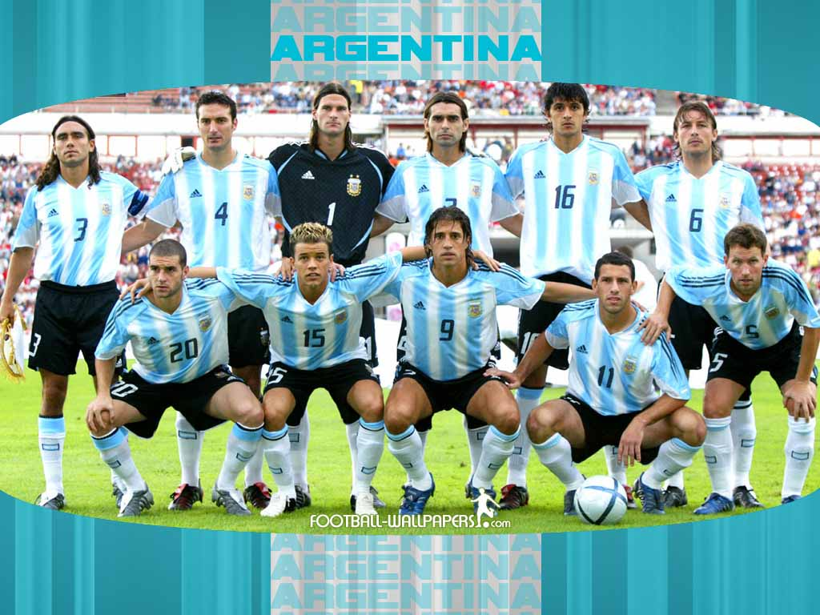
Los deportes
El favorito : el fútbol
El equipo nacional – Los Albicelestes
Notes:
From word reference.com
albiceleste adjetivo (Arg) (de selección argentina) of the Argentinian national team; un triunfo ~ an Argentinian victory
(de color) skyblue

Slide 22
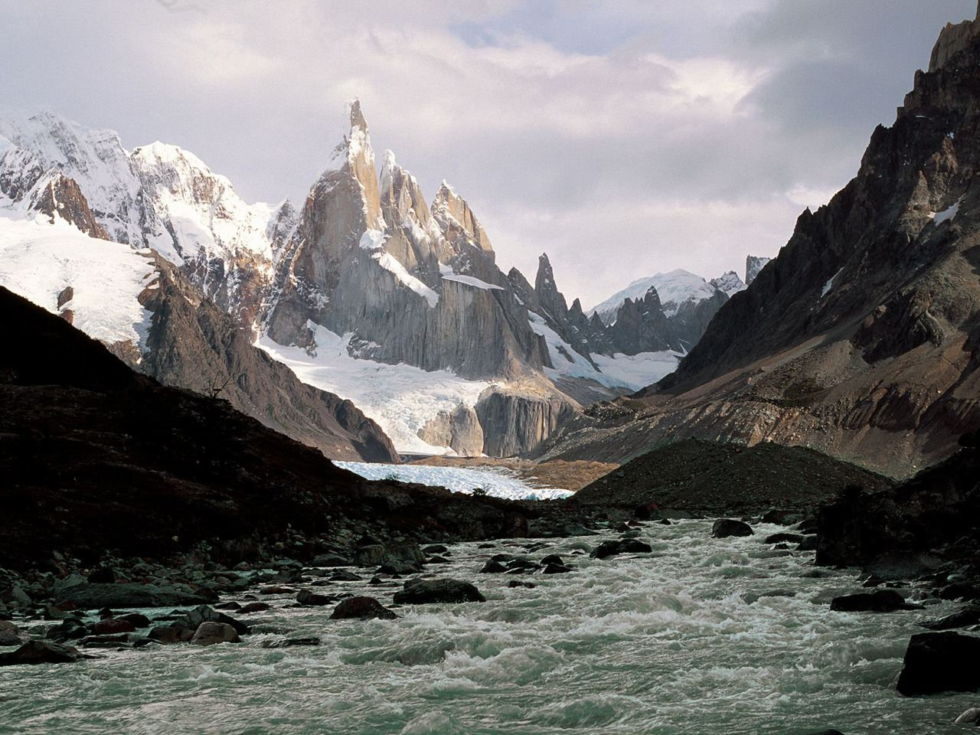
Las vacaciones
La Patagonia
Camping
Kayaking
Mountain climbing
skiing

Slide 23
References
http://www.seashellsandsunflowers.com/2009/07/argentina-independence-day.html
http://jedsundwall.com/love-freedom-wear-a-red-hat/

Slide 24
References
http://www.google.com/imgres?q=map+of+south+america&num=10&hl=en&biw=1280&bih=699&tbm=isch&tbnid=5aOz2vrN0yt-nM:&imgrefurl=http://www.lib.utexas.edu/maps/americas.html&docid=s0QHdRBCtHQRBM&imgurl=http://www.lib.utexas.edu/maps/americas/south_america_pol98.jpg&w=1106&h=1436&ei=eyecToqkEZSCsgLb88y8Cg&zoom=1&iact=hc&vpx=297&vpy=160&dur=3&hovh=256&hovw=197&tx=114&ty=101&sig=105694901193420010360&sqi=2&page=1&tbnh=145&tbnw=109&start=0&ndsp=24&ved=1t:429,r:1,s:0
http://www.google.com/imgres?q=map+of+argentina&num=10&hl=en&biw=1280&bih=699&tbm=isch&tbnid=RLRCj1NbHvFKkM:&imgrefurl=http://www.lonelyplanet.com/maps/south-america/argentina/&docid=Ph7bFjpMDXbTMM&imgurl=http://www.lonelyplanet.com/maps/south-america/argentina/map_of_argentina.jpg&w=466&h=350&ei=GiicToXdNOWHsgLmiIHlBA&zoom=1&iact=hc&vpx=185&vpy=189&dur=918&hovh=194&hovw=259&tx=195&ty=85&sig=105694901193420010360&sqi=2&page=1&tbnh=142&tbnw=188&start=0&ndsp=24&ved=1t:429,r:0,s:0
http://www.google.com/imgres?q=buenos+aires+argentina&num=10&hl=en&biw=1280&bih=699&tbm=isch&tbnid=_v__-E4ZjHLCbM:&imgrefurl=http://www.etraveltrips.com/blog/%3Fp%3D1170&docid=KZ8ixzWwwYT-bM&imgurl=http://www.etraveltrips.com/blog/wp-content/uploads/2011/04/Buenos-aires-argentina_1.jpg&w=800&h=600&ei=eyicTq79DqepsQKkl73cBA&zoom=1&iact=hc&vpx=451&vpy=345&dur=456&hovh=194&hovw=259&tx=157&ty=94&sig=105694901193420010360&sqi=2&page=1&tbnh=149&tbnw=205&start=0&ndsp=17&ved=1t:429,r:7,s:0
http://www.argentina.org.au/people.htm
http://www.google.com/imgres?imgurl=https://lh5.googleusercontent.com/_sD3A6Lxz3Z4/TW85rgkbmBI/AAAAAAAJa4Y/FseJ4ZEHe88/DSC_2399.JPG&imgrefurl=http://buildersinternational.info/2011/03/26/argentina-2011-people-just-people-in-argentina/&h=1600&w=1063&sz=107&tbnid=LyEC-vHW-oAnjM:&tbnh=186&tbnw=123&prev=/search%3Fq%3Dpeople%2Bfrom%2BArgentina%2Bimages%26tbm%3Disch%26tbo%3Du&zoom=1&q=people+from+Argentina+images&docid=v2onxtpEslDxuM&hl=en&sa=X&ei=JIWdTraAKcKtsQLXtJmBCg&sqi=2&ved=0CCgQ9QEwAA&dur=3433
http://www.google.com/imgres?imgurl=http://www.argentina-travel.org/images/argentina-people.jpg&imgrefurl=http://www.argentina-travel.org/people.php&h=282&w=382&sz=27&tbnid=PFt6gjR3qIjbJM:&tbnh=90&tbnw=122&prev=/search%3Fq%3Dpeople%2Bfrom%2BArgentina%2Bimages%26tbm%3Disch%26tbo%3Du&zoom=1&q=people+from+Argentina+images&docid=RjYZ8tD8F7SZjM&hl=en&sa=X&ei=JIWdTraAKcKtsQLXtJmBCg&sqi=2&ved=0CDsQ9QEwBg&dur=4429
http://www.google.com/imgres?q=people+from+Argentina+images&hl=en&sa=X&noj=1&tbm=isch&prmd=imvns&tbnid=J0nEih5BrhFSkM:&imgrefurl=http://www.demotix.com/news/364701/argentina-beats-greece-and-south-koreans-celebrate-london&docid=iQto0h_sd2KIVM&imgurl=http://www.demotix.com/sites/default/files/imagecache/large_610x456_scaled/photos/argentina-beats-greece-and-south-koreans-celebrate-london_364231.jpg&w=610&h=433&ei=UYadTtuIAerFsQKt7MXzCQ&zoom=1&iact=hc&vpx=358&vpy=379&dur=2764&hovh=189&hovw=267&tx=226&ty=115&sig=105694901193420010360&page=14&tbnh=145&tbnw=222&start=220&ndsp=15&ved=1t:429,r:6,s:220&biw=1280&bih=699
http://www.infohostels.com/notizia.php?chiave=666
http://en.wikipedia.org/wiki/List_of_countries_by_literacy_rate
http://www.google.com/imgres?q=literacy&num=10&um=1&hl=en&biw=1280&bih=699&tbm=isch&tbnid=rcV-SUdlulYvvM:&imgrefurl=http://thinkwriteshare.bavts.org/groups/&docid=SKzuXYwMNq0dUM&imgurl=http://thinkwriteshare.bavts.org/groups/literacy/public/a610b.jpg&w=750&h=895&ei=N8yeTvjiDua1sQLv1KXgCQ&zoom=1&iact=rc&dur=385&sig=105694901193420010360&sqi=2&page=1&tbnh=143&tbnw=118&start=0&ndsp=18&ved=1t:429,r:8,s:0&tx=47&ty=61

